Slide 1

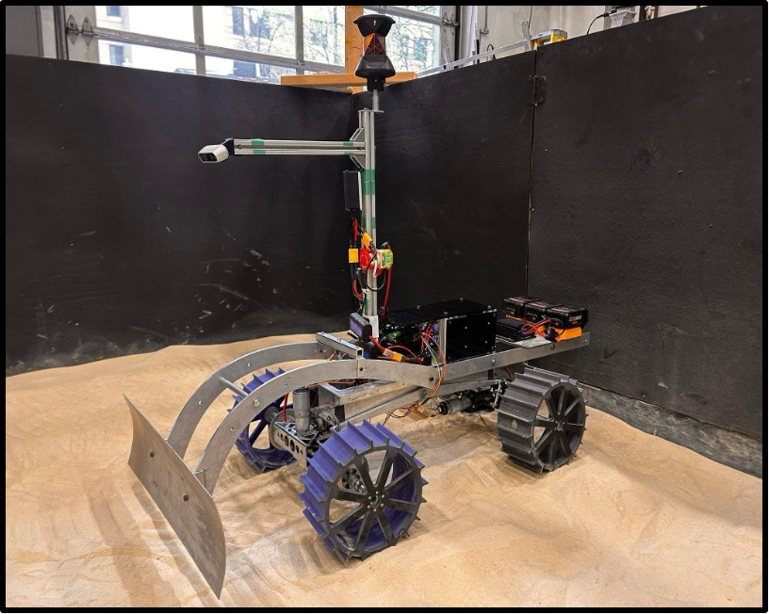

Lunar ROADSTER
(Robotic Operator for Autonomous Development of Surface Trails and Exploration Routes)
“Starting with a foothold on the Moon, we pave the way to the cosmos”

Slide 2
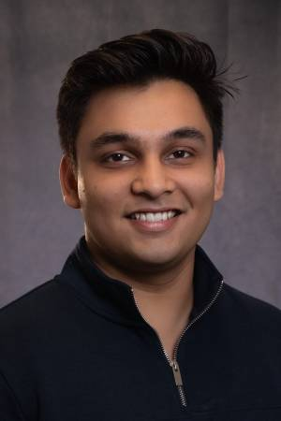


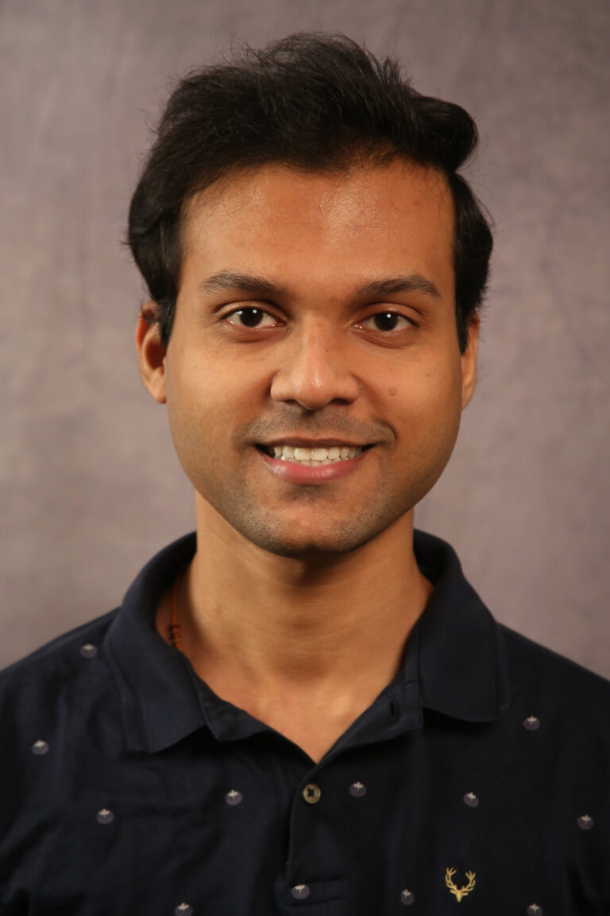


The Team
Ankit Aggarwal
Deepam Ameria
Bhaswanth Ayapilla
Simson D’Souza
Boxiang (William) Fu
Dr. William “Red” Whittaker
Notes:
-Introduce team

Slide 3
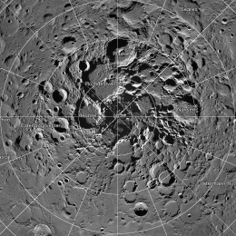
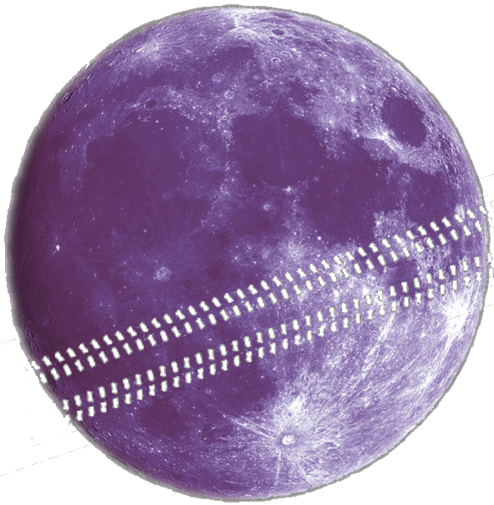
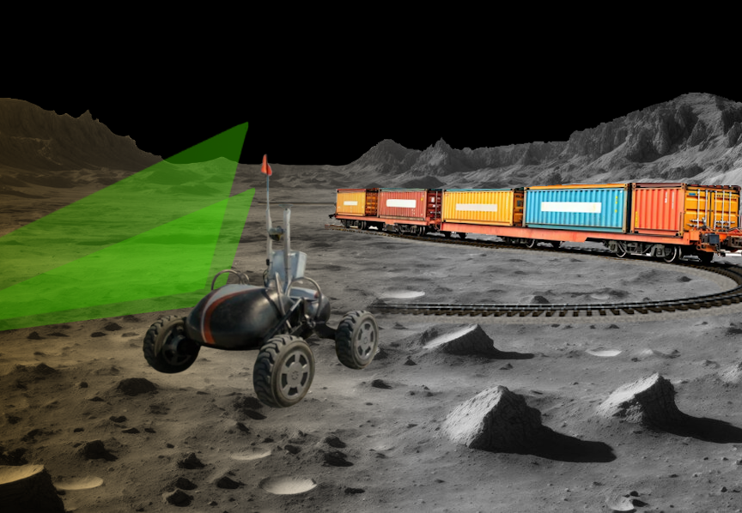
Motivation: The Lunar Polar Highway
CIRCUMNAV
Is it possible for a solar-powered rover to repeatedly drive around the Moon and never encounter a sunset?
Notes:
Humanity is returning to the Moon, particularly the south pole, as a long-term outpost.
For sustainable exploration, we need reliable infrastructure—starting with a traversable route.

Slide 4
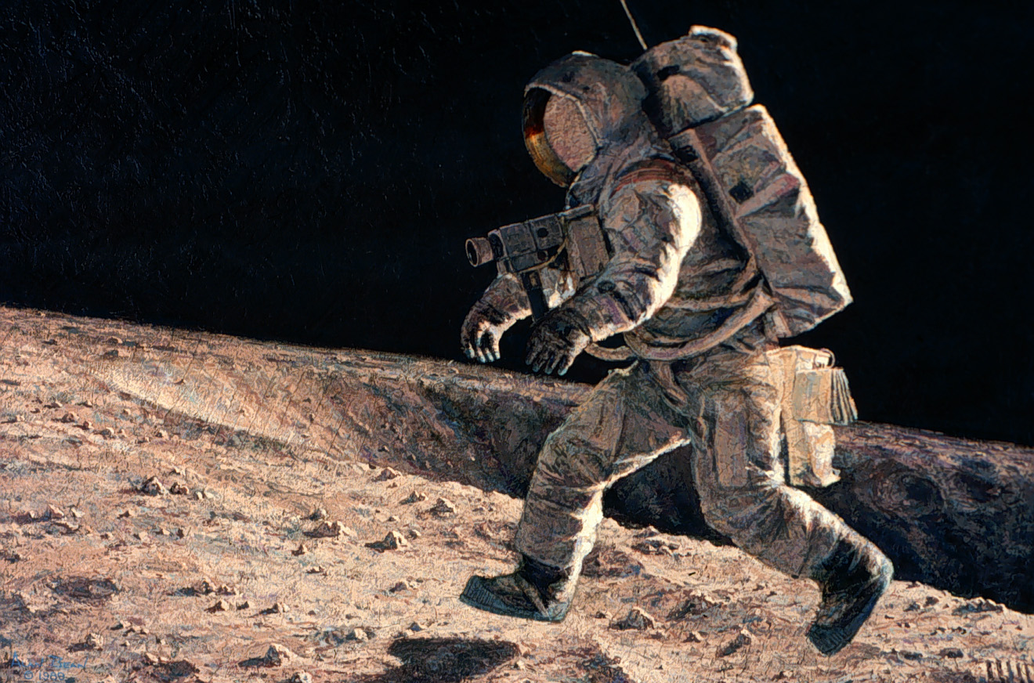
Motivation: The Lunar Polar Highway
Sun-synchronous circumnavigation around Moon at 28 days x 24 hr = 672 hour sun rotation
Jogging speed if the route was flat, circular and traversable
At equator 11,000 km 16 kph
At 50 deg 7,040 km 10 kph
At 60 deg 5,500 km 8 kph
At 70 deg 3,700 km 6 kph
At 75 deg 2,800 km 4 kph
At 80 deg 1,870 km 3 kph
At 81 deg 1,529 km 2.5 kph
Notes:
Turns out, at 75° latitude, a rover can achieve sun-synchronous circumnavigation around the pole at just 4 km/h(that’s literally just walking jogging speed).
But this assumes a flat, nearly circular path—something that doesn’t exist naturally. That’s where our project comes in.

Slide 5
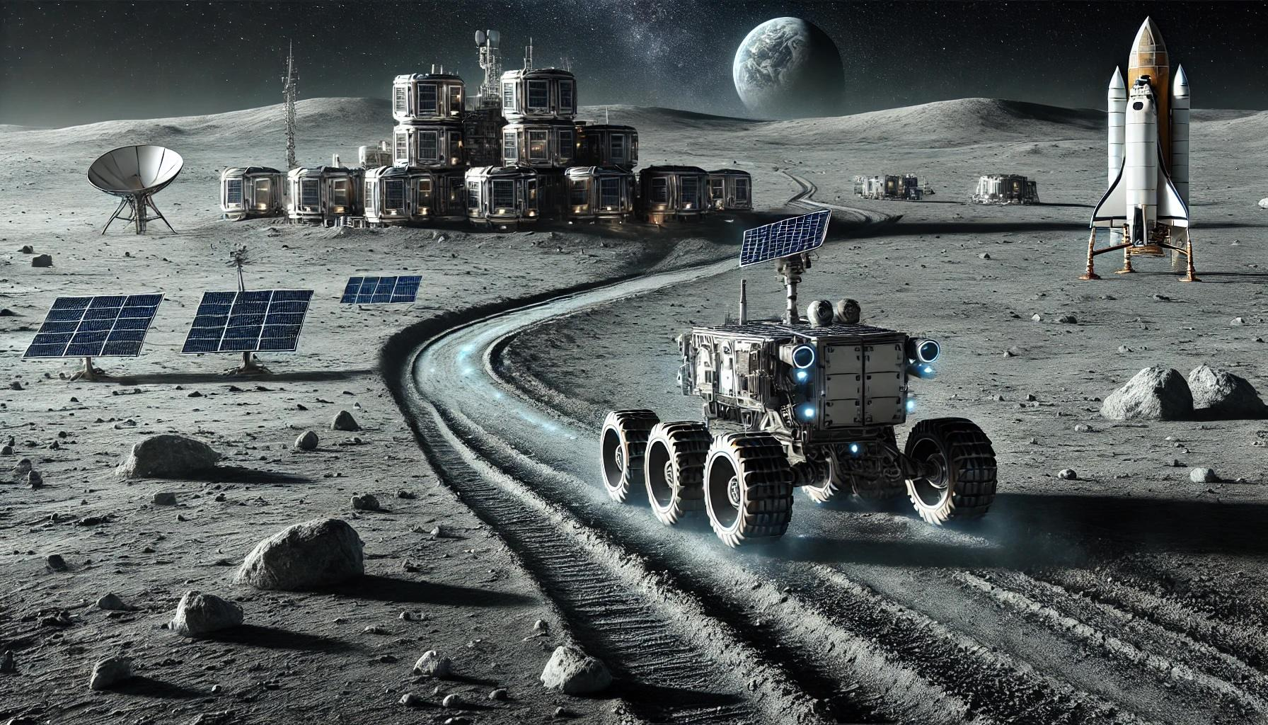
The Project: Lunar ROADSTER
An autonomous moon-working rover capable of finding ideal exploration routes and creating traversable surface trails.
By grooming trail paths, rovers with less traversing capabilities will be able to travel at higher speeds and higher power efficiencies.
A traversable and circuitous trail path will allow rovers to maintain sun-synchronicity, thereby allowing machines to run for much longer.
The groomed trails will become the backbone for colonization of the Moon by enabling transportation, logistics and enterprise development.
Notes:
Lunar ROADSTER
Autonomous Moon-working rover, capable of finding optimal exploration routes and creating traversable surface trails (30)

Slide 6
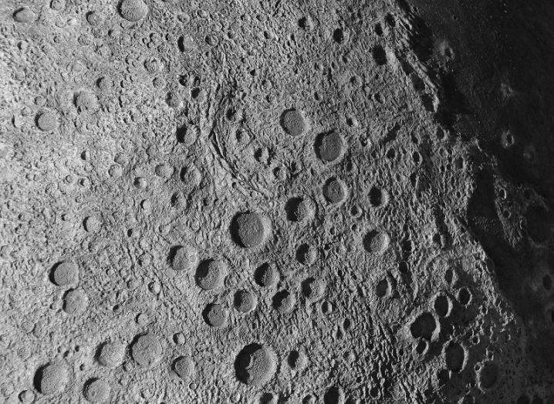
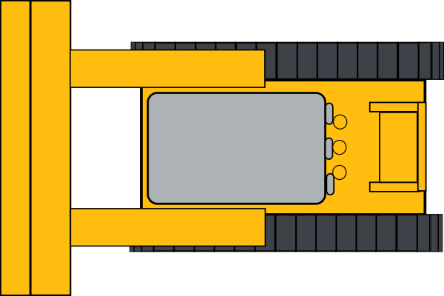
Use Case: Circular Path Grooming
Lunar ROADSTER
Reference Latitude
Groomed Path
Crater to Avoid
Original Traversable Path
Craters to Groom
Notes:
This is our primary use case. The dotted line represents a chosen latitude, the blue path represents the original, rough, circuitous path
The green lines represent the groomed path that makes the original path much safer, direct and energy-efficient for solar powered rovers.
The rover will create this path while grooming certain craters in its path, while avoiding big/deep craters

Slide 7
Use Case: Circular Path Grooming
Lunar ROADSTER
Reference Latitude
Groomed Path
Crater to Avoid
Original Traversable Path
Craters to Groom
Notes:
This is our primary use case. The dotted line represents a chosen latitude, the blue path represents the original, rough, circuitous path
The green lines represent the groomed path that makes the original path much safer, direct and energy-efficient for solar powered rovers.
The rover will create this path while grooming certain craters in its path, while avoiding big/deep craters

Slide 8
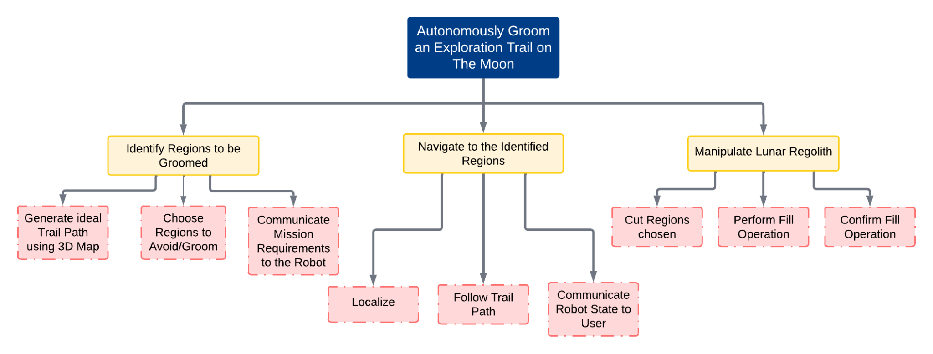
Objectives Tree
Notes:
Our work is structured into three main objectives, each with specific sub-objectives, ensuring a methodical approach
My colleagues will now dig deeper on these objectives. Over to you Simson.

Slide 9
Functional Requirements (Mandatory)
Sr. No. | Mandatory Functional Requirement
M.F.1 | Shall perform trail path planning
M.F.2 | Shall operate autonomously
M.F.3 | Shall localize itself in a GPS denied environment
M.F.4 | Shall navigate the planned path
M.F.5 | Shall traverse uneven terrain
M.F.6 | Shall choose craters to groom and avoid
M.F.7 | Shall grade craters and level dunes
M.F.8 | Shall validate grading and trail path
M.F.9 | Shall communicate with the user
Notes:
FR1 - off board on the moon station (laptops)
FR2, FR3, FR4 - Mission requirements communicated, robot localizes, navigates autonomously
FR5 - Physical capability
FR6, FR7 - Path planning -> Tool planning - manipulation
FR8 - Validation -> sensor suite
FR9 - Communication infrastructure

Slide 10
Non-Functional Requirements (Mandatory) Modified
Sr. No. | Parameter | Description
M.N.1 | Weight | The rover must weigh under 50kg
M.N.2 | Cost | The cost for the project must be under $5000
M.N.3 | Computing Capacity | The onboard computer should be able to run all required tasks
M.N.4 | Size/Form Factor | The rover should measure less than 1m in all dimensions
Notes:
NFM1 - Align with the performance requirements
NFM2 - MRSD Project Budget
NFM3- Onboard computing - Localization, Tool Planning, Navigation, Validation
NFM4 - Moon Pit, 5x5, NFM1

Slide 11
Non-Functional Requirements (Desirable)
Sr. No. | Parameter | Description
D.N.1 | Technological Extensibility | The system will be well documented and designed so that future teams can easily access and build on the work
D.N.2 | Aesthetics | Requirement from sponsor, the rover must look presentable and lunar-ready
D.N.3 | Modularity | To enable tool interchangeability, the tool assemblies must be modular and easy to assemble/disassemble
D.N.4 | Repeatability | The system will complete multiple missions without the need of maintenance
Notes:
NFD1 - Well structured and documented for future
NFD2 - Unique sponsor requirement
NFD3 - Want our robot to be modular, have easily changeable manipulators/tools, adjustable to similar other missions
NFD4 - Want it to be able to perform the missions multiple times, thus improving robustness

Slide 12
Performance Requirements (Mandatory)
Modified
Sr. No. | Performance Metrics
M.P.1 | Will plan a path with cumulative deviation of <= 25% from chosen latitude’s length
M.P.2 | Will follow planned path to a maximum deviation of 10%
M.P.3 | Will climb gradients up to 15° and have a contact pressure of less than 1.5 kPa
M.P.4 | Will avoid craters >= 0.5 metres and avoid slopes >= 15°
M.P.5 | Will fill craters of up to 0.5 meters in diameter and 0.1m in depth
M.P.6 | Will groom the trail to have a maximum traversal slope of 5°

Slide 13
Current System Status

Slide 14
Subsystem Completion Status
Subsystem | Completion % | Future Work
Sensors | 100% | None
Computations | 60%
1. Jetson and Docker | 100% | None
2. Localization Stack | 85% | Tune and improve Skycam based localization
3. Navigation Stack | 60% | Test and tune navigation stack (global + local)
4. Perception Stack | 60% | Fine tune, integrate with planning and navigation
5. Validation Stack | 100% | None
6. Planning Stack | 40% | Obtain Robot poses
7. Behavior Executive Node | 40% | Integrate all computation units into FSM
External Infrastructure | 100% | None
Mechanical | 100%
1. Dozer Assembly | 100% | None
2. Wheel Assembly | 100% | None
Actuation | 100% | None
Electrical Power | 100% | None

Slide 15
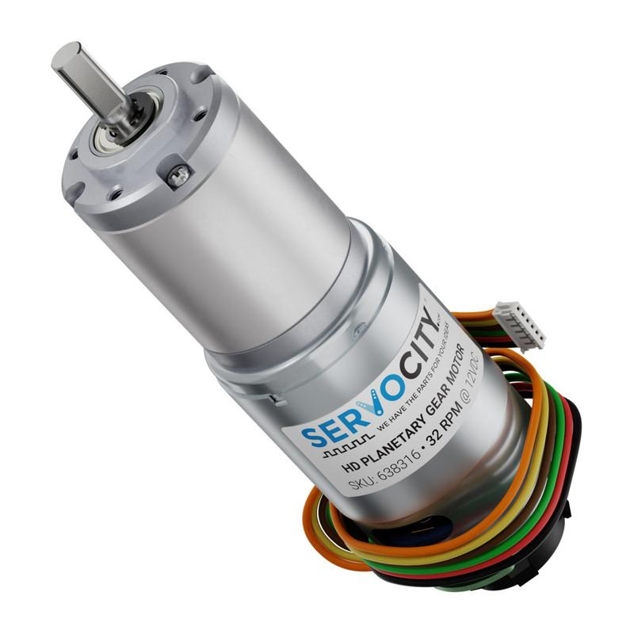
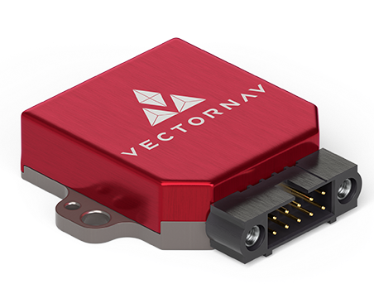
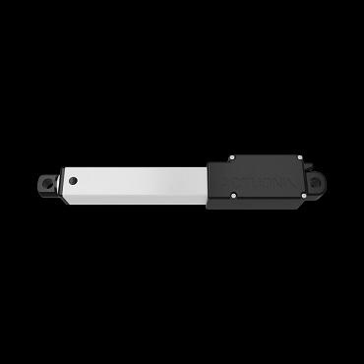
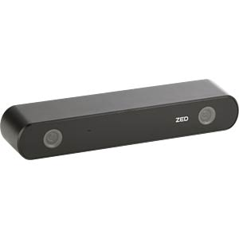
Description: Sensors Subsystem
Description: All sensors used on the rover for computations.
Requirements:
Wheel Encoders (x4)
Mast Depth Camera (ZED 2i)– New!
IMU (VectorNav)
Actuator Feedback Sensor
Expected Functionality: The sensor data is published to various ROS topics and can be used inside the Docker container to perform computations.

Slide 16
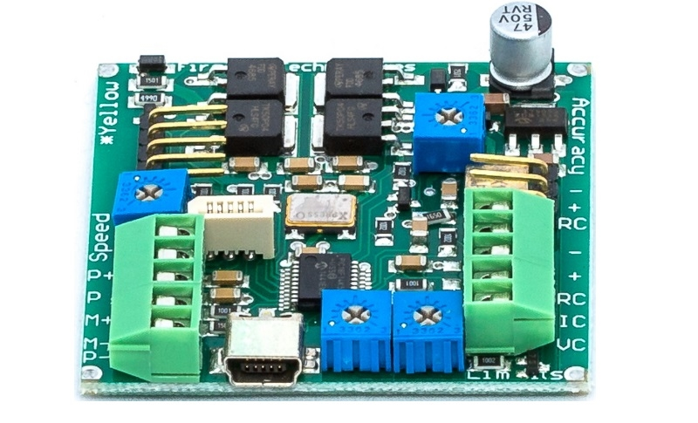
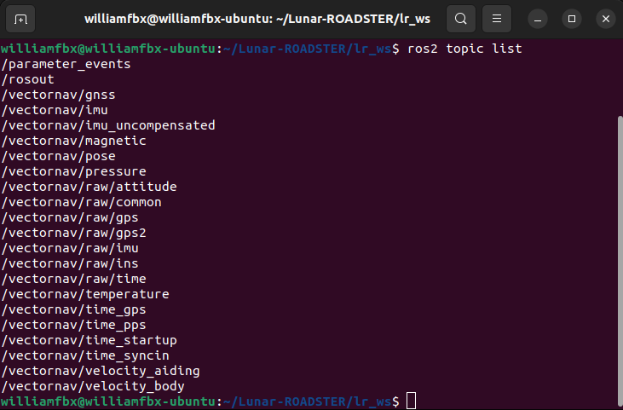
Status: Sensors Subsystem
Implementation:
IMU implemented using VectorNav ROS package
Wheel Encoder parsed using micro-ROS
Purchased actuator has a feedback potentiometer
Obtained point cloud feed using ZED 2i wrappers
Challenges:
CUDA compatibility issues with ZED SDK on Jetson Xavier – tackled by upgrading to Orin
IMU issues – tackled by purchasing new IMU
Status: 100% Complete
IMU, wheel encoder, and linear actuator finalized. Upgraded RealSense to ZED 2i during summer.

Slide 17
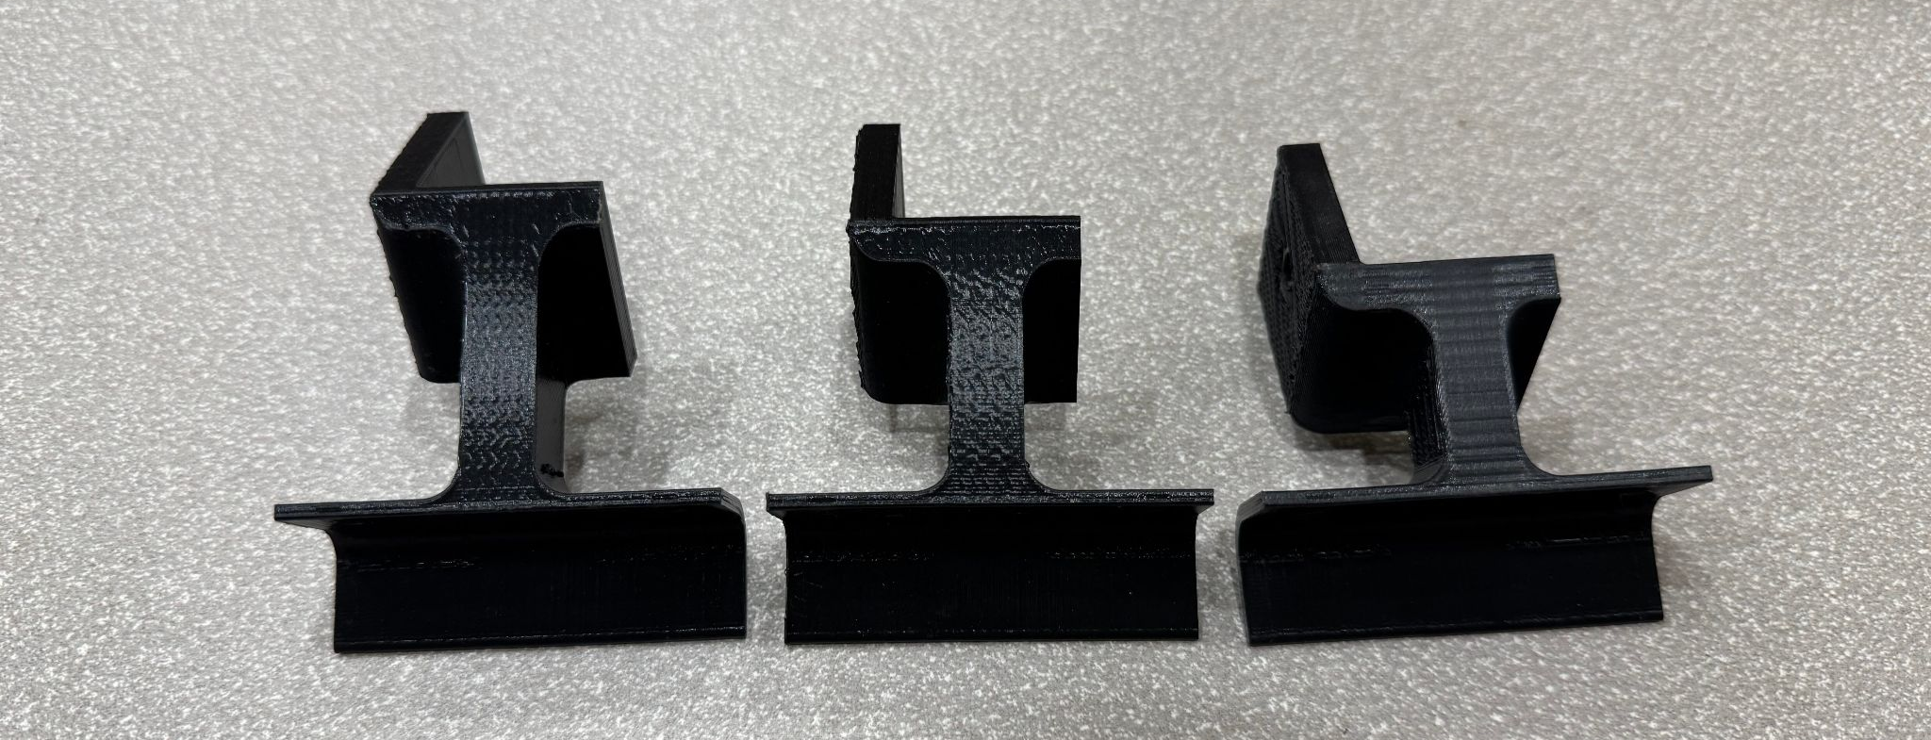
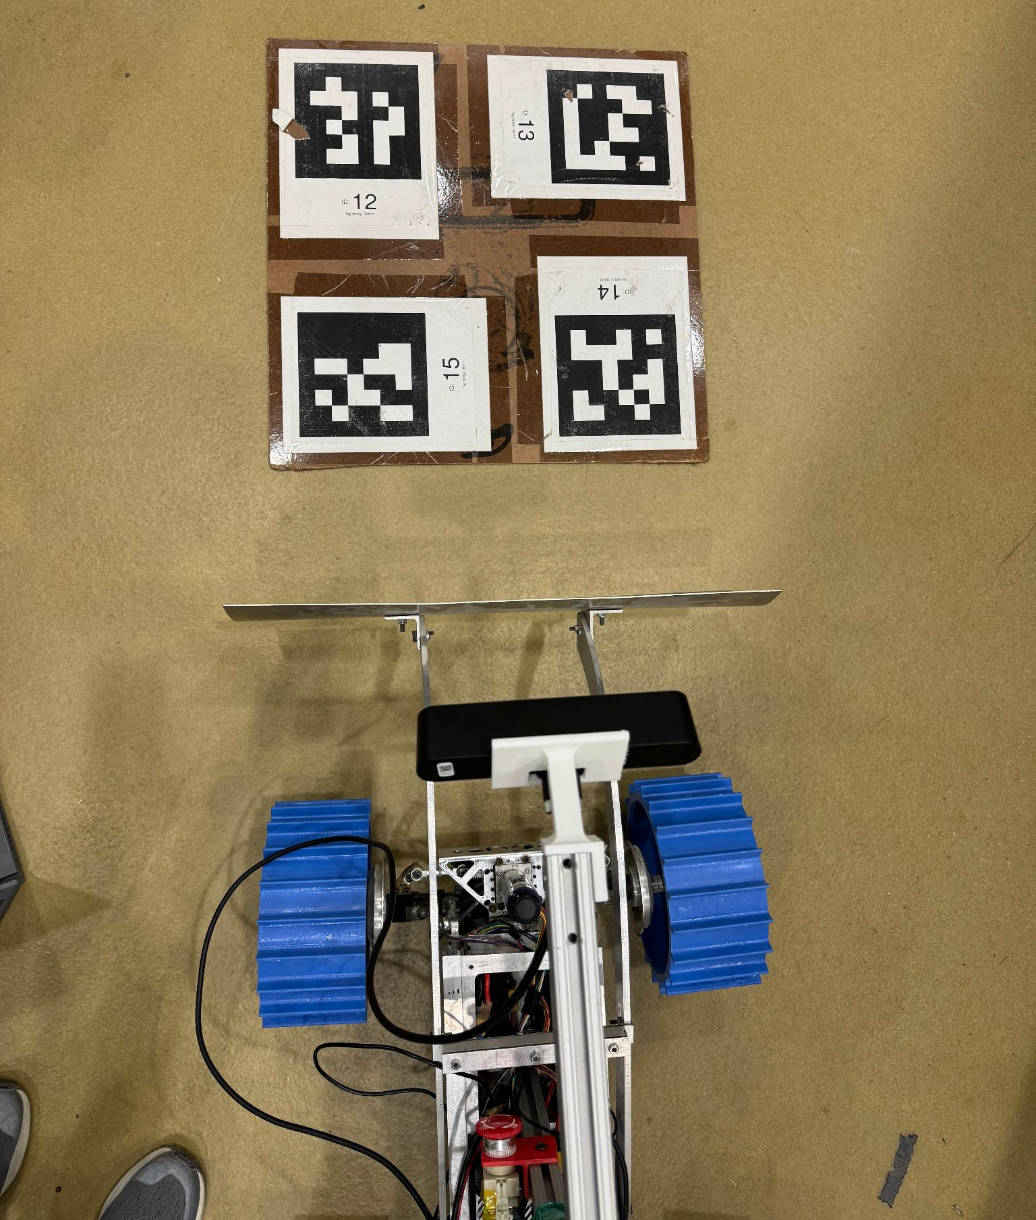
Evaluation: Sensors Subsystem
Modelling:
New CAD designed and 3D printed mast depth camera mounts of 30, 40, 45, and 50 degree angles relative to mast
Analysis:
50 degree angled camera mount gives the best view of craters
However, if tool height is above 15%, occlusion occurs
Point cloud obtained from ZED 2i is much denser than Realsense
Testing:
Fall T09: CPU/GPU Usage of Autonomous Stack is Below Orin Compute Limits
Fall T10: Maintenance, Reliability and Quality Assurance Test

Slide 18
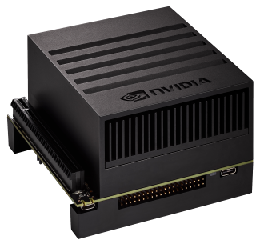
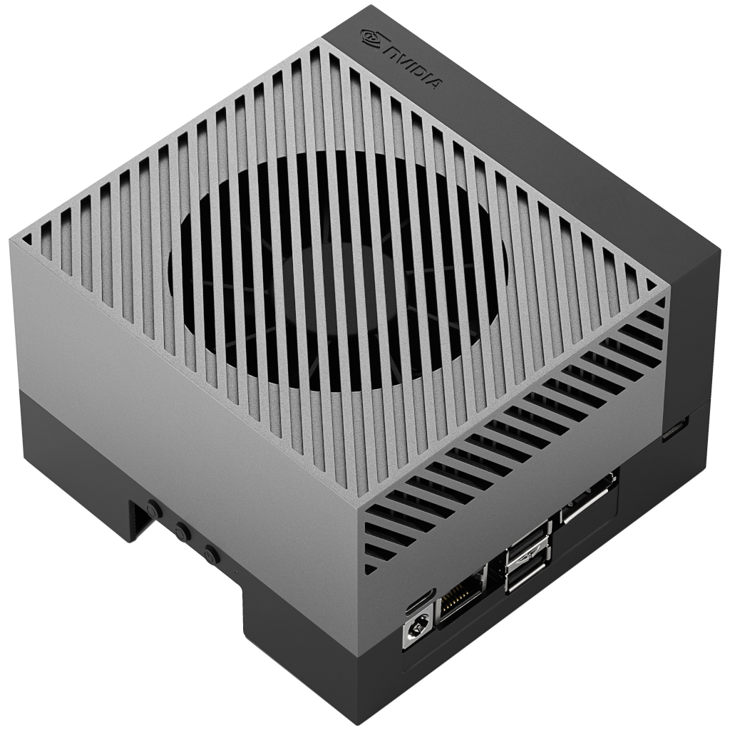
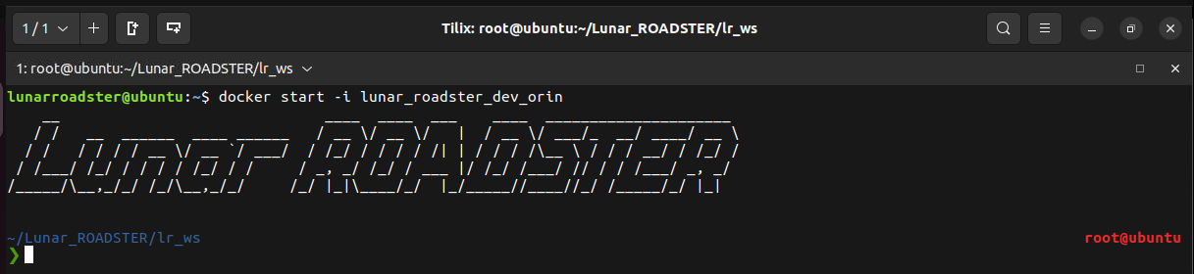
Description: Computations Subsystem
Jetson and Docker
Description: Set up the Jetson Orin with Docker to host and run all critical system packages
Requirements:
NVIDIA Jetson Orin – New!
LAN Router
Team laptop (operations terminal)
Expected Functionality:
Acts as primary on-board compute
Runs ROS2 Humble
Runs micro-ROS
Hosts and manages all necessary packages and device drivers inside Docker containers
~4x CUDA cores
~1.7x faster CPU performance
~2x memory
~1.5x higher bandwidth
Jetson AGX Xavier
Jetson Orin

Slide 19
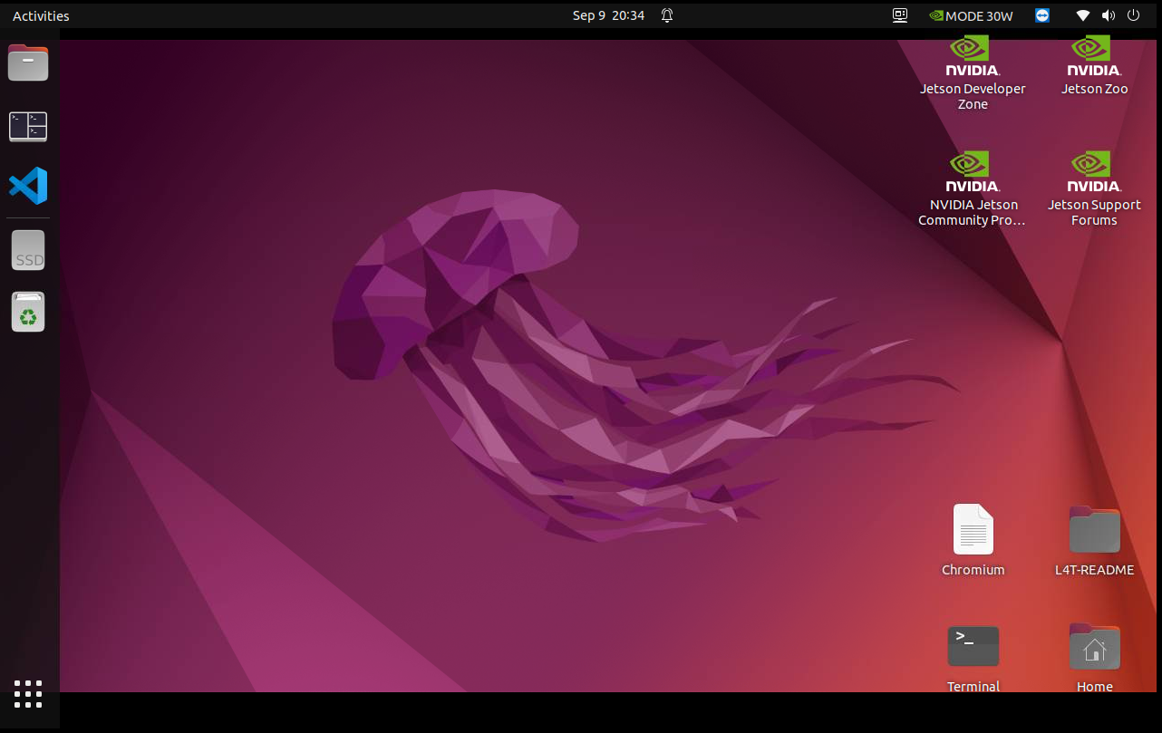
Status: Computations Subsystem
Jetson and Docker Unit
Implementation:
Connect Jetson to rover’s power system
Assigned static IP on the LAN to enable SSH-based remote access from operations terminal
Start docker container and initialize all core services and packages
Tmux used for master launcher
Challenges:
Setup of a VNC server for remote GUI access
Status: 100% Complete
Integrated ZED SDK drivers

Slide 20
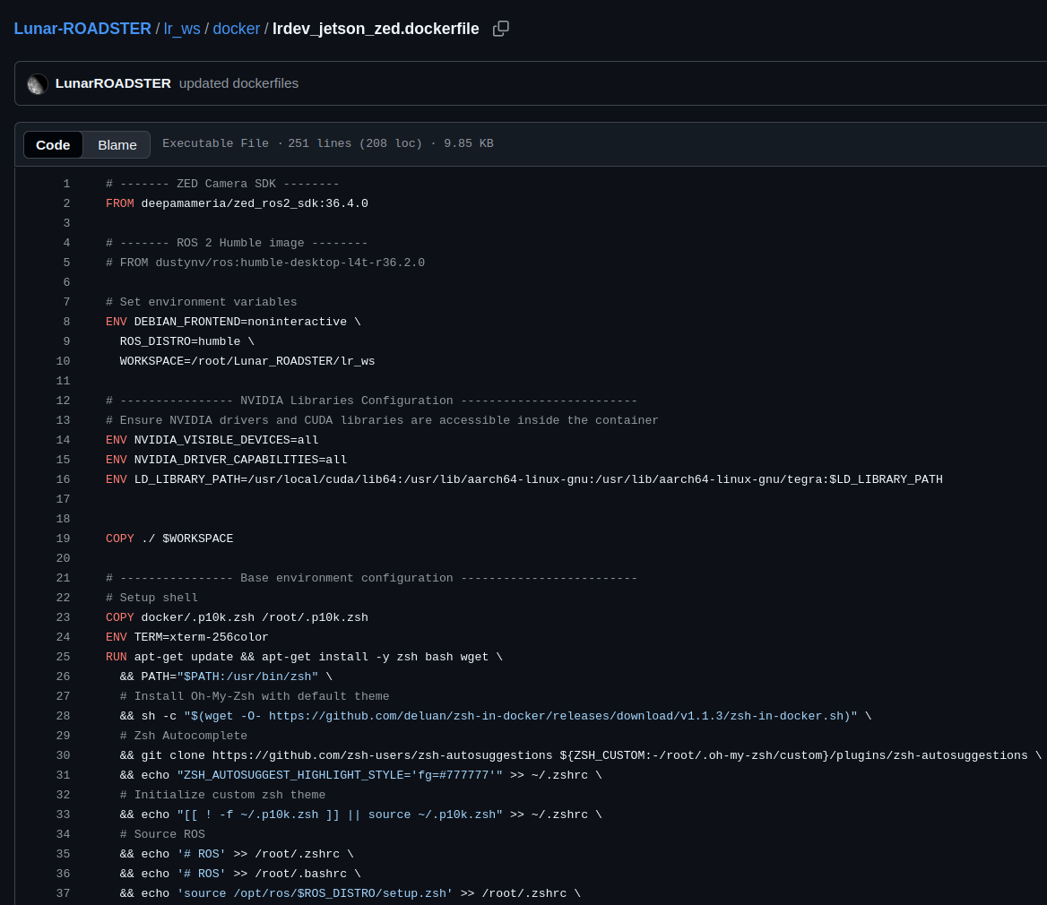
Evaluation: Computations Subsystem
Jetson and Docker Unit
Modelling:
Created custom Dockerfile built on ZED SDK image that installs all required system packages
Analysis:
Verified that all required nodes and drivers start successfully inside the container
Testing:
Fall T01: Rerun Spring Validation Demonstration
Fall T09: CPU/GPU Usage of Autonomous Stack is Below Orin Compute Limits

Slide 21
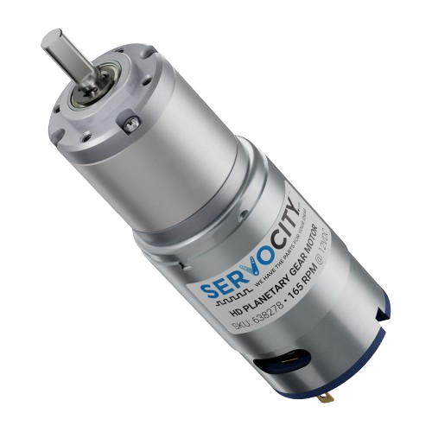
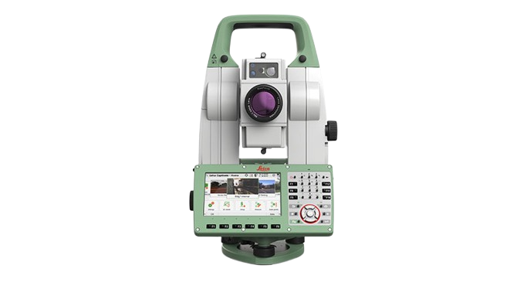
Description: Computations Subsystem
Total Station Localization
Description: Localize the rover in the Moon Yard
Requirements:
Leica TS16 Total Station
NVIDIA TX2 Relay Chip + LAN
VectorNav IMU
Wheel Encoders
Expected Functionality: Accurately localize rover pose inside the Moon Yard, to be used further for navigation
Leica TS16 Total Station
VectorNav VN-100 IMU
Wheel Encoders
Global Localization
Local Localization
Extended Kalman Filter
Rover Pose

Slide 22
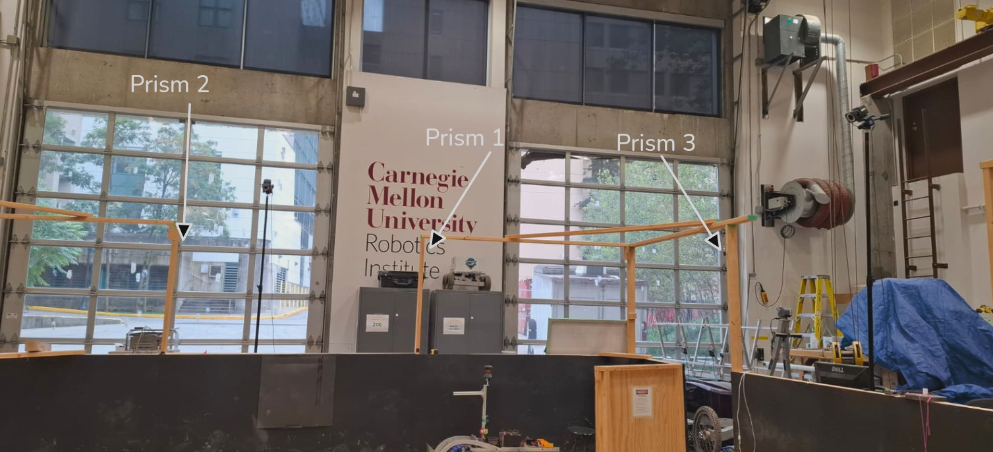
Status: Computations Subsystem
Total Station Localization
Implementation:
On-board IMU and encoders used for local localization
Total station data fused with IMU and encoders for global localization
EKF running on Jetson using robot_localization package, now tuned to prevent odometry drift
Yaw calibration to ensure IMU data is w.r.t map frame
Fixed frame shifts issue caused by total station battery replacement by using resection method (uses 3 total station prisms instead of 2)
Challenges:
Incorrect Jetson Docker network permissions blocked two-way communication
Minor offset introduced when total station battery is replaced, causing frame inconsistencies
Status: 100% Complete

Slide 23
Evaluation: Computations Subsystem
Total Station Localization
Modelling:
Configured and tuned EKF to fuse sensor inputs
Set up frame transforms to ensure all sensor data aligns properly at base_link frame
Performed yaw calibration to ensure consistent orientation data from IMU
Analysis:
Analyzed pose stability and drift over time during testing
Analyzed sensor noise and measurement delays, tuned EKF parameters to minimize odometry drift
Assessed effect of total station resections and battery swaps on accuracy
Testing:
Spring T09: Rover can localize itself accurately
Spring T15: Spring Validation Demo Test

Slide 24
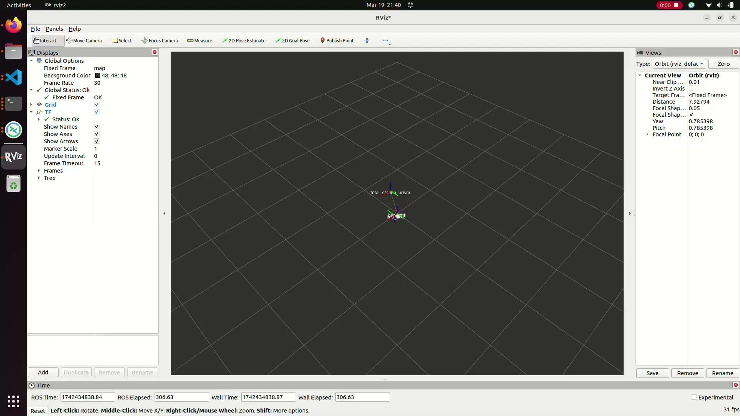
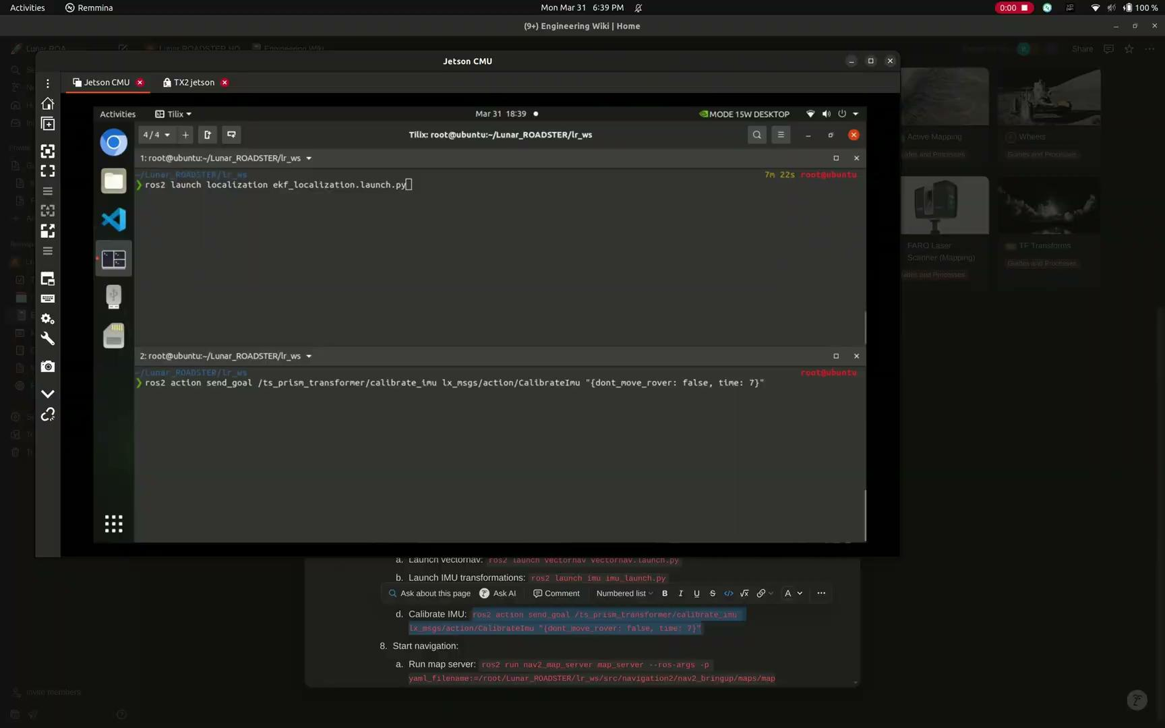
Evaluation: Computations Subsystem
Total Station Localization
Localization drift issue
Drift corrected + Yaw calibrated

Slide 25
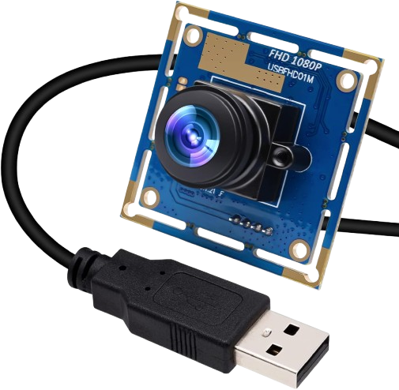
Description: Computations Subsystem
Skycam Localization
Description: Localize the rover in the Moon Yard using rover mounted Skycam – New!
Requirements:
Fisheye camera (Skycam)
VectorNav IMU
Wheel Encoders
Expected Functionality: Accurately localize rover pose inside the Moon Yard, to be used further for navigation
Fisheye Camera
VectorNav VN-100 IMU
Wheel Encoders
Global Localization
Local Localization
Extended Kalman Filter
Rover Pose

Slide 26
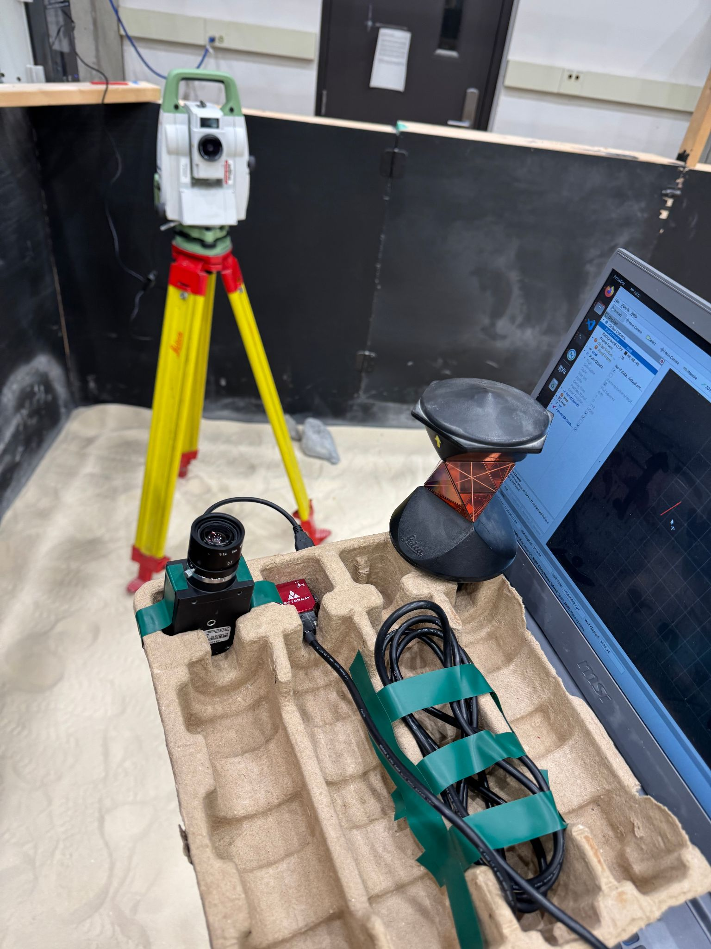
Status: Computations Subsystem
Skycam Localization
Implementation:
Data Collection Pipeline: Saves and indexes raw Skycam camera images along with ground truth localization provided by total station
Training Pipeline: Train a neural network using PyTorch by regressing camera image against position
Deployment Pipeline: Deploys network to a ROS node at runtime
Challenges:
Trained model is inaccurate (MSE localization error is ~1 meter)
Corners of Moon Yard is recently covered, need to retake training data to account for this
Status: 85% Complete
Tune MSE localization error to be below 10cm

Slide 27
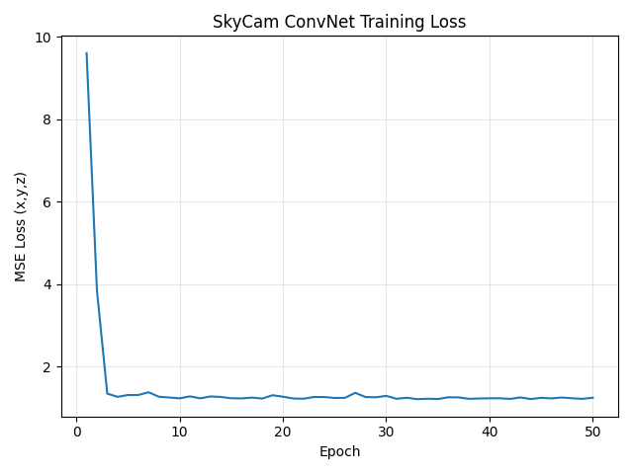
Evaluation: Computations Subsystem
Skycam Localization
Modelling:
Tried different neural network architectures (vanilla, ConvNet, etc)
Analysis:
Split the training data into training and validation datasets
Analyzed the localization MSE loss on validation dataset
Compared localization error against total station method
Testing:
Fall T08: SkyCam Localization Validation

Slide 28
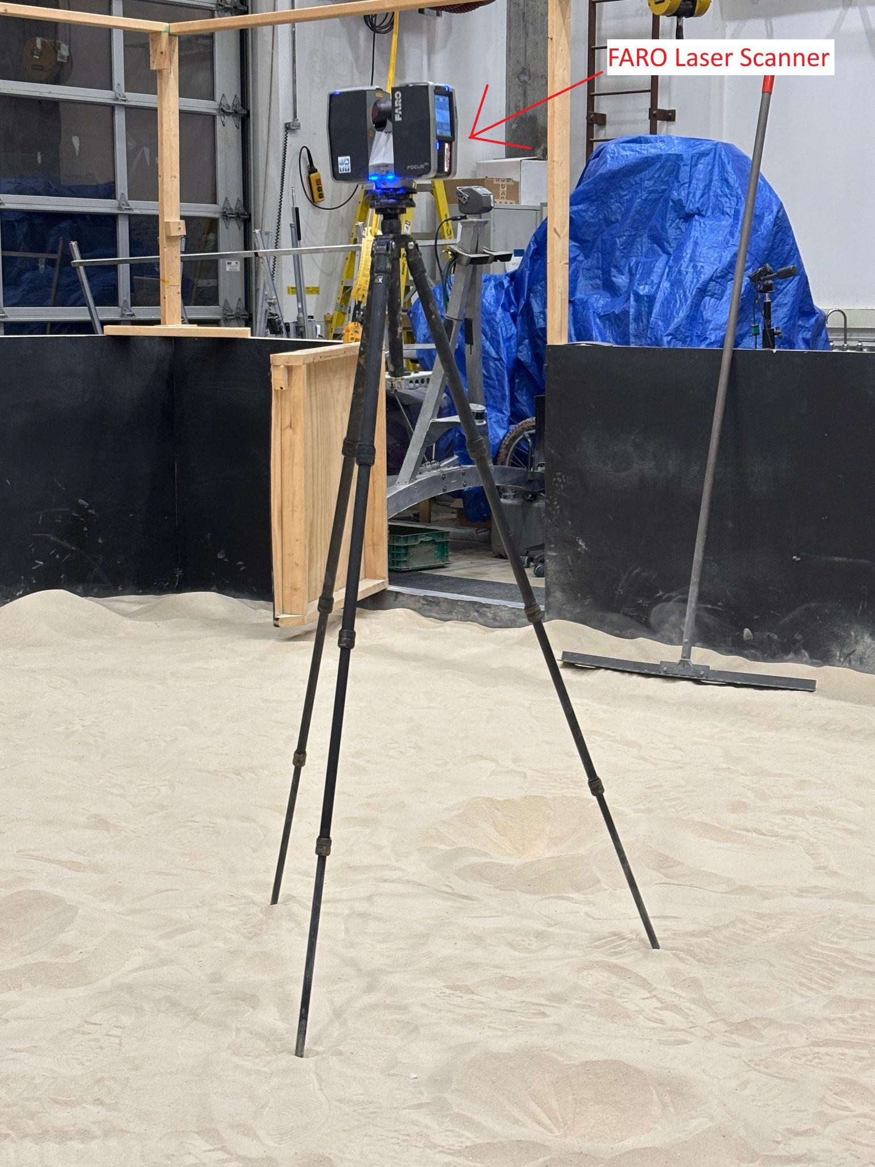
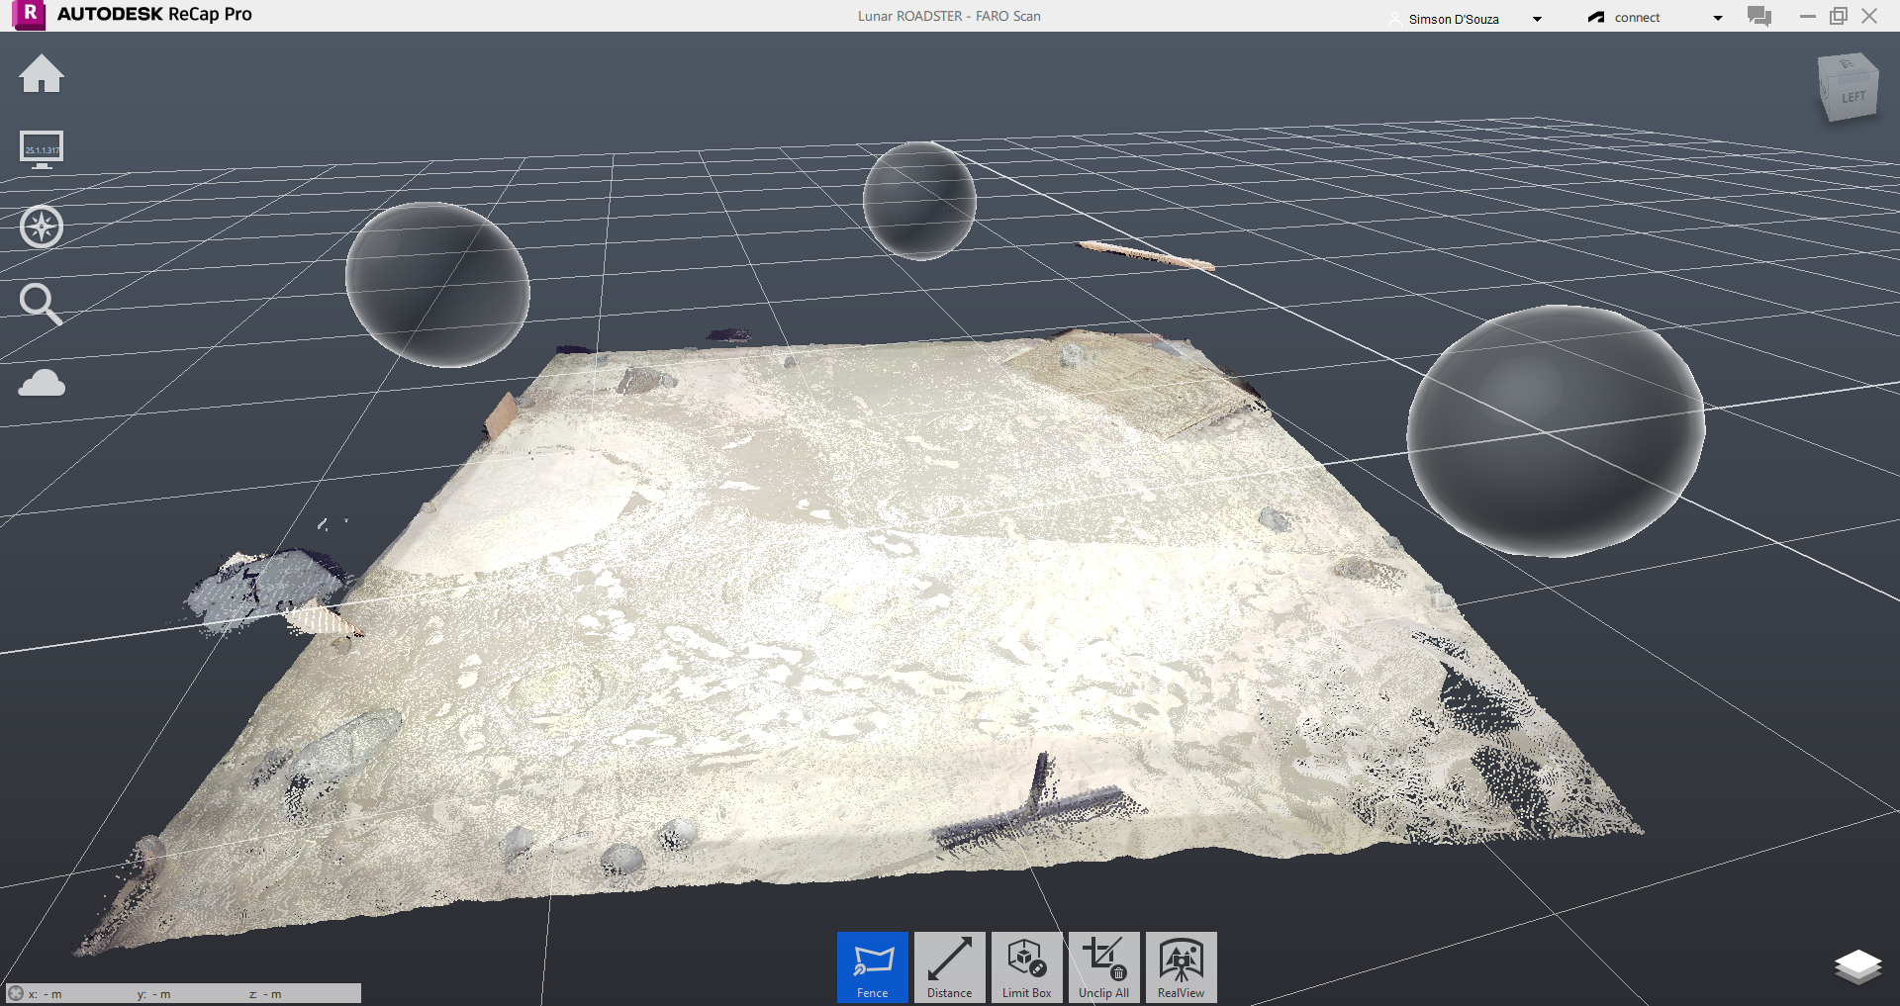
Description: Computations Subsystem
Navigation Stack
Description: Obtain a global plan between craters based on target poses and navigate the rover to their locations
Requirements:
FARO Laser Scanner
NVIDIA Jetson Orin
ZED 2i Depth Camera
Rover
Team laptop (operations terminal)
Expected Functionality:
Accurately detect and classify gradable craters
Ensure no gradable crater is overlooked
Compute an optimal navigation path while avoiding obstacles (non-gradable craters)
Navigate and reach the goal location correctly

Slide 29
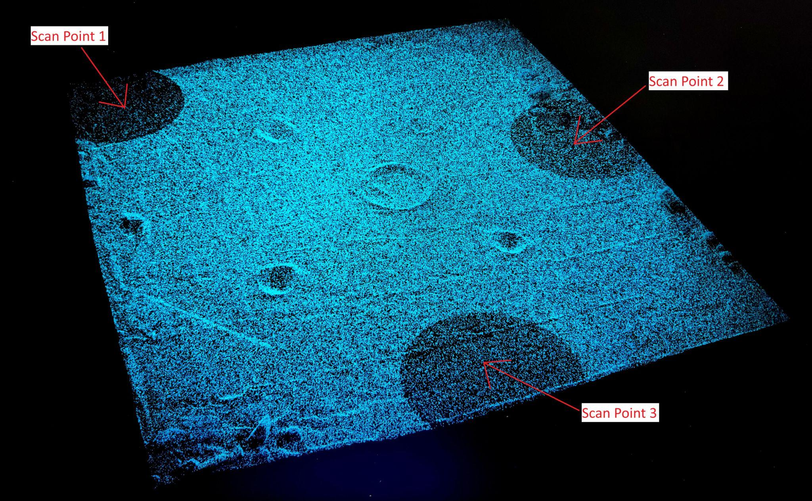
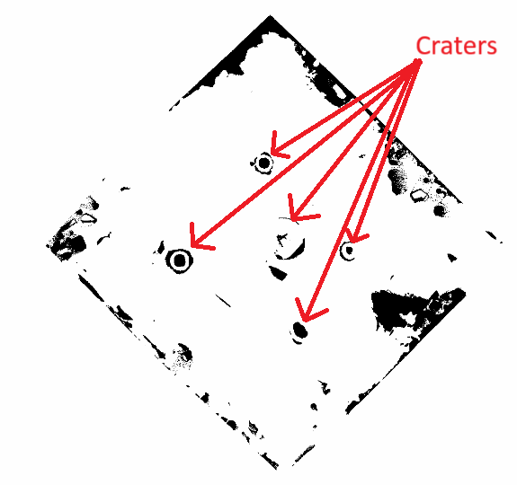
Status: Computations Subsystem
Navigation Stack
Implementation:
FARO Laser Scanner used to map the Moon Yard and obtain a high density point cloud
The point cloud is converted into an occupancy grid using RANSAC and thresholding – contains craters centroid and diameter information
Global Path Planner uses the occupancy grid map to compute a smooth trajectory between craters, taking into account Ackermann primitives and ring bias
Pure Pursuit Global Controller executes the planned path and reaches the desired goal (close to the crater)
MPC Local Controller uses information from perception and planning stacks to reach desired target poses
Navigation stack is integrated with tool planner to perform transport assignments
Challenges:
FARO output file (.fls) was incompatible with the PCL library and ROS.
Fine-tune global planner and global/local controller parameters for optimal performance on our robot
Status: 60% Complete (Tune Navigation Stack)
Moon Yard Scan Visualization
Global Costmap

Slide 30
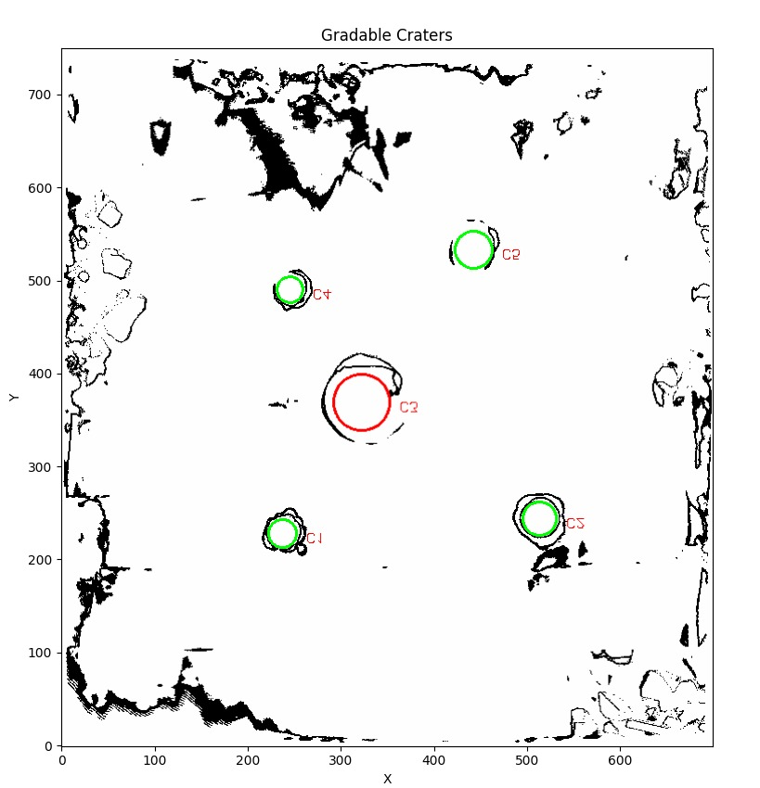
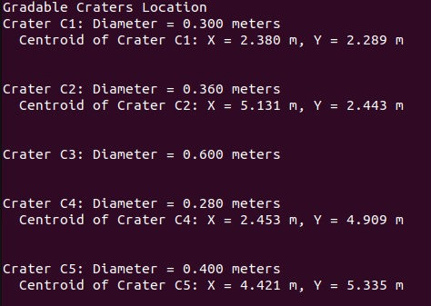
Evaluation: Computations Subsystem
Navigation Stack
Gradable Craters
Modeling:
Generated dense point cloud maps by taking multiple FARO scans and updated the map origin for consistent localization and navigation frames
Custom Global Path Planner that takes into account various costs and heuristics for optimal planning
Custom Global and Local Controllers to allow more control over robot movement
Used RViz extensively to visualize and debug transformations and paths
Analysis:
Evaluated planned paths for smoothness, obstacle avoidance, and feasibility
Analyzed factors affecting navigation: localization noise, data delay, computation load, and parameter tuning
Testing:
Fall T02: Global Path Planner Accuracy Test
Fall T03: Filtering and Selection of Gradable Craters
Fall T04: Navigation planner maximum deviation test
Fall T06: Repeatability Test of Local Navigation Controller
Fall T11: Fall Validation Demo Preparation Test
Identified Gradable Craters
Gradable Craters Location

Slide 31

Evaluation: Computations Subsystem
Navigation Stack

Slide 32
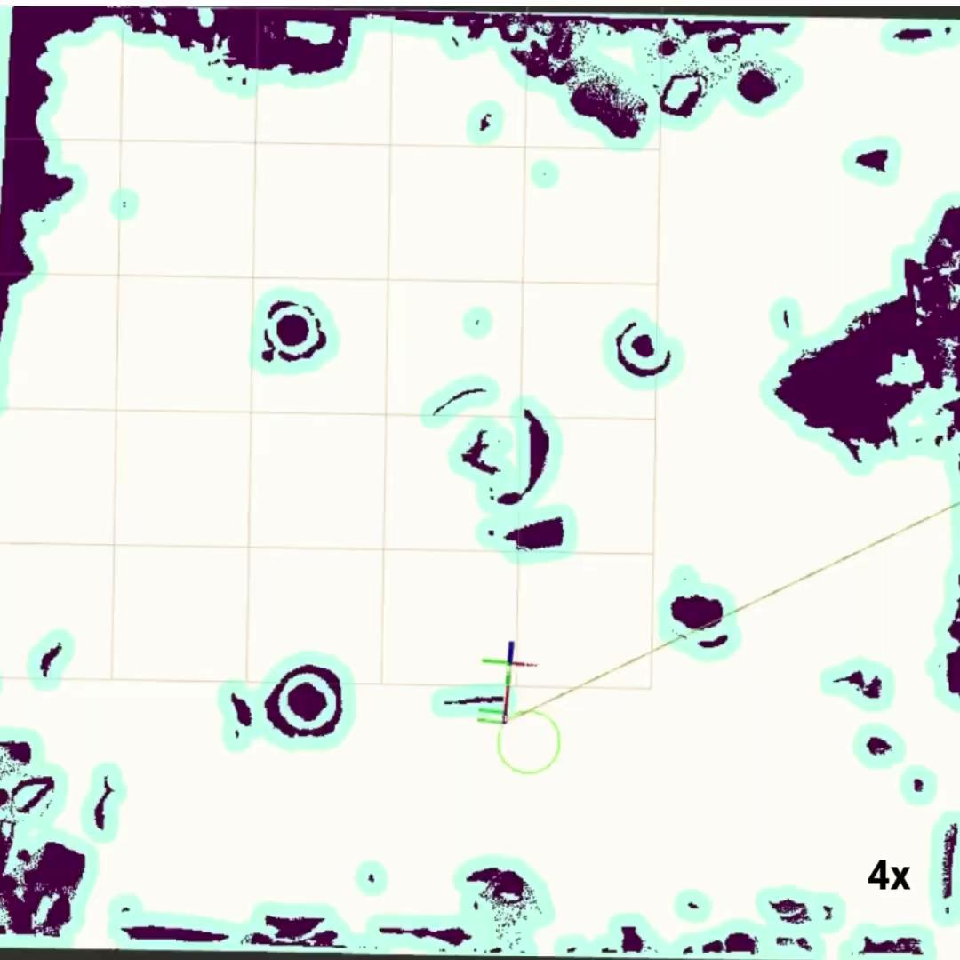
Evaluation: Computations Subsystem
Navigation Stack

Slide 33
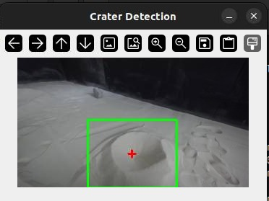
Description: Computations Subsystem
Perception Stack
Description: Uses RGB-D sensor to detect craters and extract coordinates for planning and navigation subsystems.
Requirements:
ZED 2i stereo camera
Camera driver packages/ROS2 Wrappers
Jetson Orin
Expected Functionality:
Output coordinates of the detected crater(s) in the world frame.

Slide 34
Status: Computations Subsystem
Perception Stack
Implementation:
Collect data for training and validating a CNN Object Detection Model
Load the trained model on edge compute
Obtain RGB raw images from ZED Camera over ROS topics
Detect craters in real-time
Obtain centroid of crater and publish on ROS topic for planning and navigation stacks
Challenges:
Rover mast moves due to rover suspension. May cause jitter in coordinates.
Compute or inference is not optimized for real-time detection
Status: 60% Complete

Slide 35
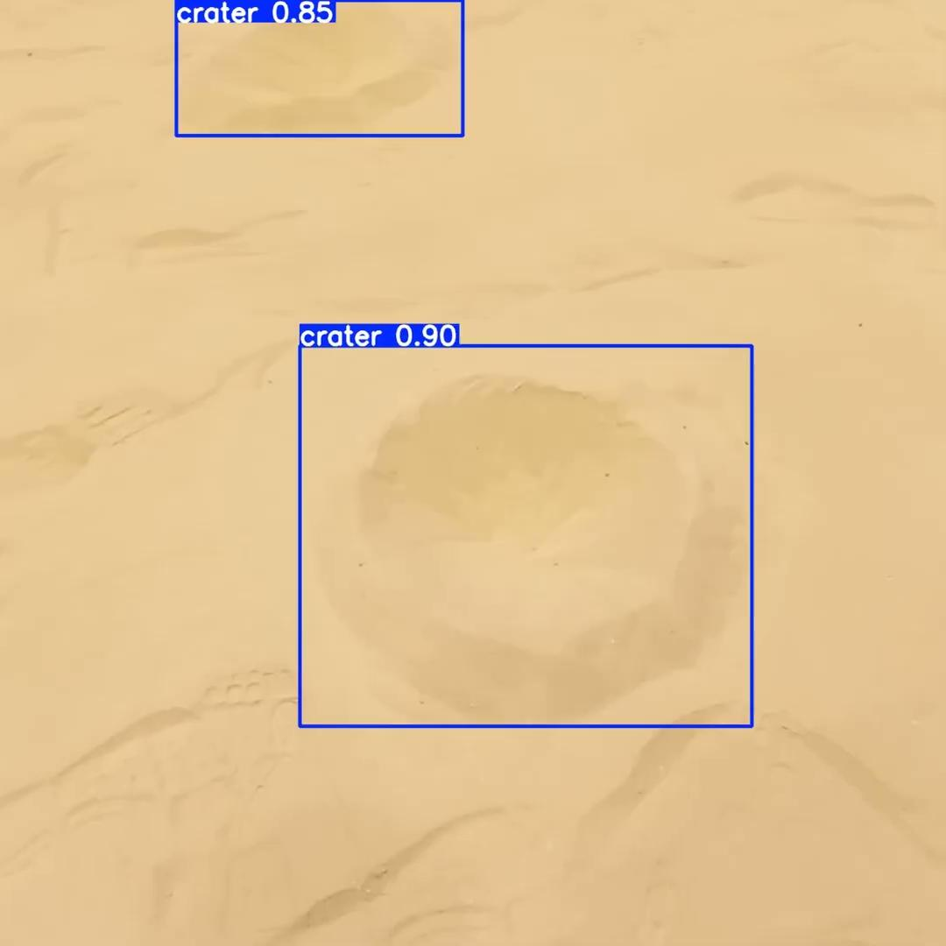
Evaluation: Computations Subsystem
Perception Stack
Modelling:
Collected dataset and annotated using Roboflow Annotation Tool
Trained YOLO v8 and validated on test videos
Transferred to Orin for online real-time perception and inference
Used bounding box analysis to determine crater centre coordinates
Analysis:
Inference is laggy and requires optimization and smoothening for persistent detection
Testing:
Fall T05: Perception Stack Crater Geometry Extraction Test

Slide 36
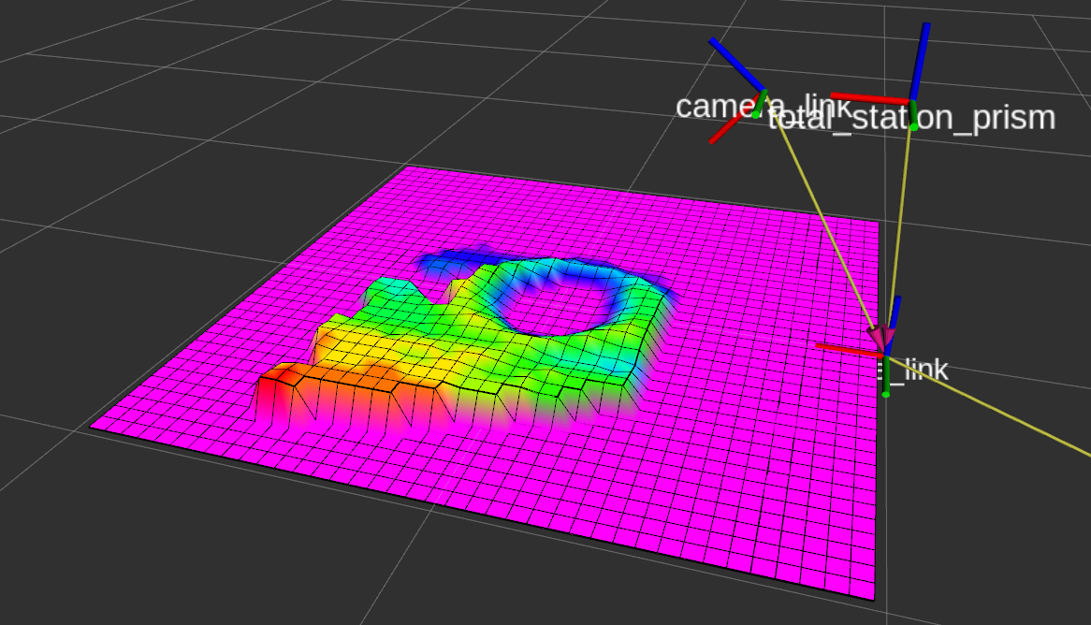
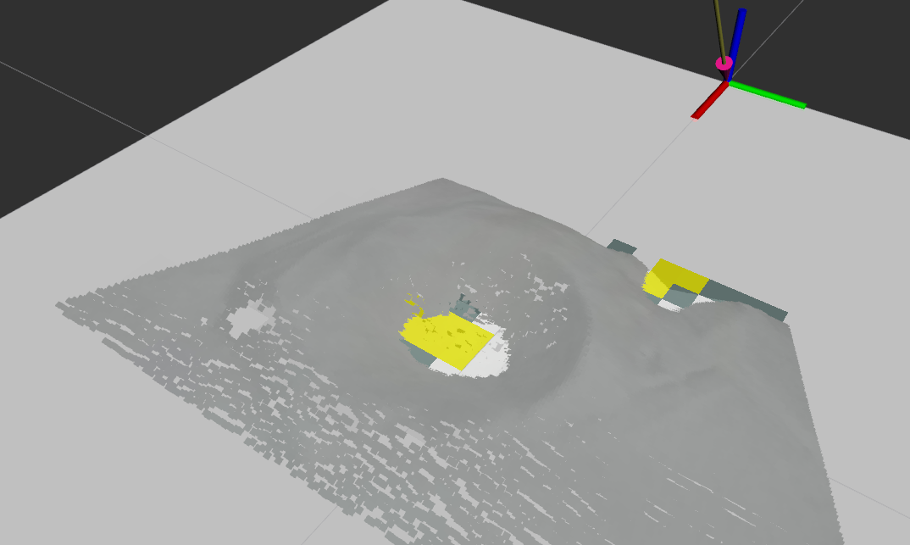
Description: Computations Subsystem
Validation Stack
Description: Validates if groomed crater satisfies maximum traversability requirement (M.P.6)
Requirements:
ZED 2i stereo camera
Camera driver packages
Jetson Orin
Expected Functionality:
Outputs boolean of grading success or failure plus additional gradient information in FOV region

Slide 37
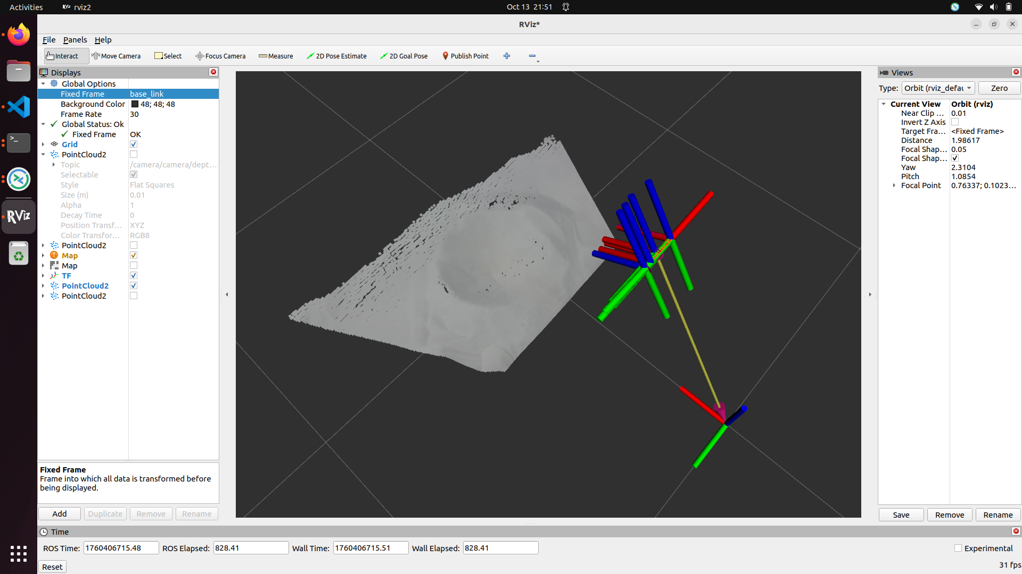
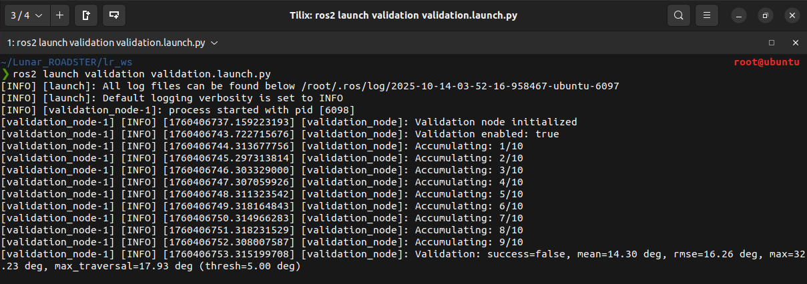
Status: Computations Subsystem
Validation Stack
Implementation:
Obtains most recent point cloud feed from the ZED camera
Voxel downsampling, and builds a KdTree
Surface normal estimation and calculate per-point slope from the vertical z-axis
Nearest neighbor smoothing and masking to filter out phantom points and walls/edges
Compute aggregate slope statistics over several frames
Challenges:
Rover mast moves due to rover suspension
Phantom points in point cloud data sometimes causes erroneous gradient estimates
Status: 100% Complete
Validation before grooming

Slide 38
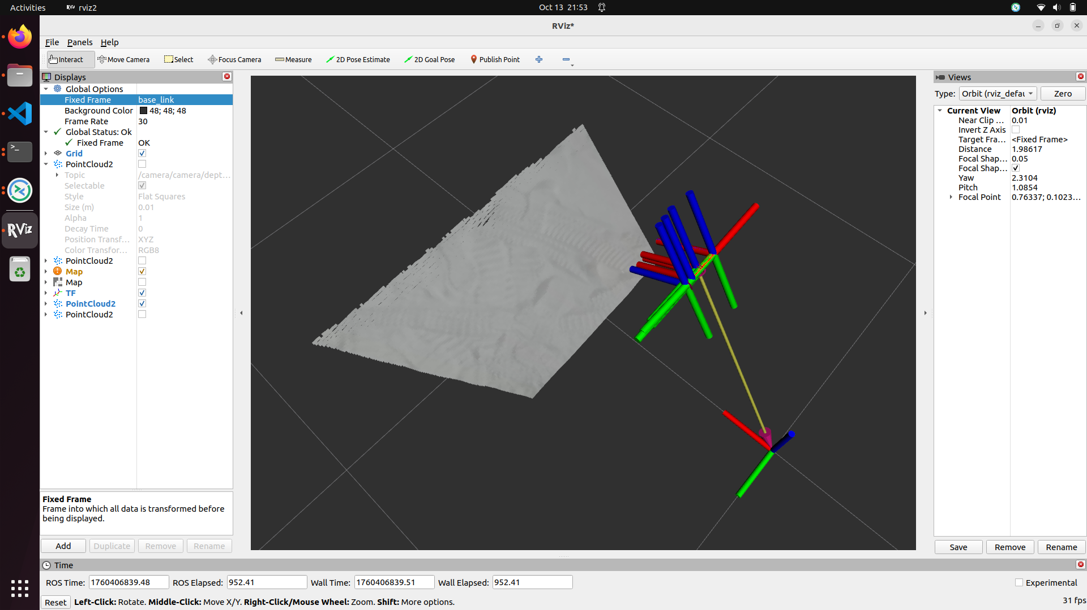
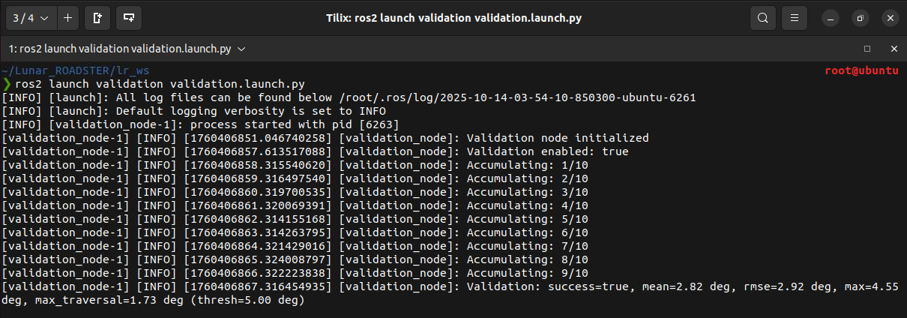
Evaluation: Computations Subsystem
Validation Stack
Modelling:
Calibrated camera {X, Y, Z, R, P, Y} so that flat ground has zero elevation and no rotation
Analysis:
Analyzed accuracy and robustness of output on different terrains (crater, flat ground, smoothed sand, facing wall, facing rock)
Testing:
Fall T07: Trail Grooming Slope Validation
Validation after grooming

Slide 39
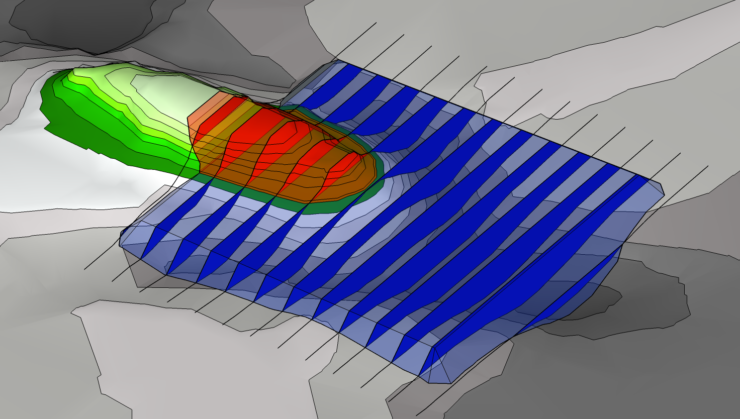
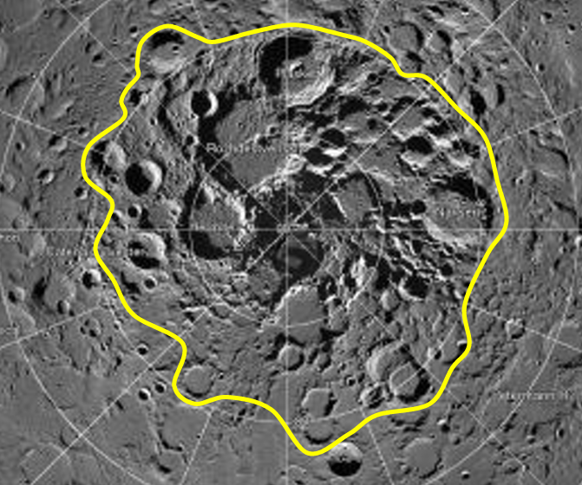
Description: Planning Stack
Description: Subsystem that plans sand manipulation by using the tool and drive train.
Requirements
Jetson Orin
Dozer Assembly
Drivetrain (with Wheel Assembly)
Global Map
Expected Functionality
Plans a control input for the tool
Plans a trajectory for the rover for manipulation
Outputs waypoints and tool trajectories to the navigation planner

Slide 40
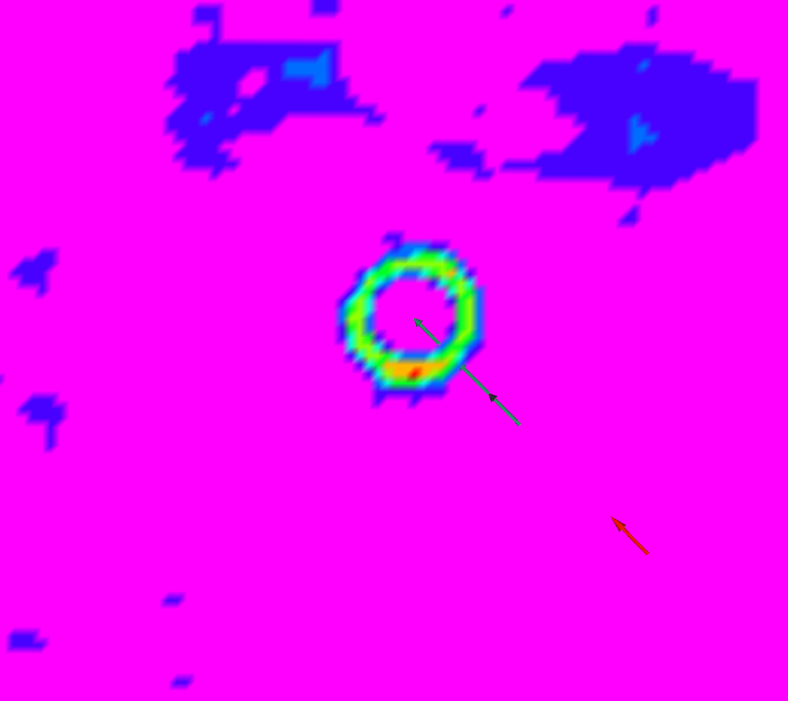
Status: Planning Stack
Implementation:
The new planning stack will be using the geometry of the crater as obtained by the perception stack.
The diameter and coordinates of the crater’s centroid will be used to create robot poses for manipulation
The tool height will be determined by the depth data obtained from the ZED
Challenges:
Accurate crater geometry will be needed
Robot poses are an estimate of an estimate, meaning they will need to be tuned
Status: 40% complete
Planned Goals
Current Goal

Slide 41

Evaluation: Planning Stack
4x
Notes:
Able to find source and sink nodes well and plan transport for one crater
Say what the poses are as they show up

Slide 42

Description: Computations Subsystem
Behavior Executive Node
Description: High level behaviour tree for entire autonomy stack
Requirements:
Sensors subsystem
Computations subsystem
External infrastructure
Mechanical subsystem
Actuation subsystem
Electrical power subsystem
Expected Functionality:
Entire system is able to grade craters autonomously
Initial Methodology for Integration

Slide 43
Status: Computations Subsystem
Behavior Executive Node
Implementation:
FSM callbacks implemented at 2 Hz
Heavy computations parallelized and detached from main thread to not block FSM node from iterating
Challenges:
Compute may not be sufficient with new modules
Status: 40% Complete
(Integrate new navigation, perception and validation unit into FSM)

Slide 44

Evaluation: Computations Subsystem
Behavior Executive Node
Modelling:
Initial FSM design sourced from Crater Grader. Adapted and modified design based on our needs to include all new packages
Analysis:
Computations take too long. Rover often completely stops for calculations
Sometimes topic messages gets missed due to high network layer traffic
Testing:
Fall T09: CPU/GPU Usage of Autonomous Stack is Below Orin Compute Limits
Fall T11: Fall Validation Demo Preparation Test

Slide 45


Description: External Infrastructure Subsystem
Description: Mission components deployed offboard the rover to support localization and communication
Requirements:
Leica TS16 Total Station
NVIDIA TX2 Relay Chip
LAN Router
Team laptop (operations terminal)
Expected Functionality:
Accurately localize {X, Y, Z}-coordinates of the rover inside Moon Yard
Establish two-way communication
Notes:
The external infrastructure involves all mission components that are not on the rover. It is responsible for accurately localizing position of the rover inside the MoonYard.

Slide 46

Status & Evaluation: External Infrastructure Subsystem
Implementation:
Total Station sends rover coordinates to TX2 relay chip, forwards data packet via LAN network to rover
Established static IP on LAN network so operations terminal can communicate via SSH
Challenges:
Incorrect Jetson Docker network permissions blocked two-way communication
Status: 100% Completed
Analysis: Investigated network permission issues inside Jetson Docker
Testing: Spring T05: External Infrastructure Test
Notes:
Our implementation involves communication using a TX2 relay chip to the onboard Jetson. The challenges we faced our network permission and establishing static IP. The work in this subsystem is completed.

Slide 47

Description: Mechanical Subsystem
Dozer Assembly
Description: Lunar terrain manipulation tool
Requirements:
Dozer blade
Dozer arms assembly
Linear actuator
Arduino Due
Expected Functionality:
Perform dozing of sand
Perform backblading
Actuate automatically based on commands from tool planner
Notes:
Dozer Assembly is our lunar manipulation tool that will automatically perform dozing and backblading of sand based on commands from the tool planner.

Slide 48

Status: Mechanical Subsystem
Dozer Assembly Unit
Implementation:
Research: Dozer shapes and sizes, actuation methodologies.
Designed the dozer assembly (blade, arms, yoke, mounts) using SolidWorks.
Shortlisted linear actuators of different gear ratios.
Manufactured and assembled all parts on the rover.
Testing with different actuators
Challenges:
Fabrication problems
Limited access to FRC Workshop
Status: 100% Completed
Notes:
Our implementation involved research, mechanical design and manufacturing the dozer. The challenges we faced are fabrication issues and limited workshop access. The task remaining is refining the dozer assembly.

Slide 49
Evaluation: Mechanical Subsystem
Dozer Assembly Unit
Excellent pushing and grading capability, owing to the shape and size of the blade, and the robust dozer arms
Notes:
These videos the development progress through iterative design.

Slide 50

Description: Wheel Assembly Unit
Description: Assembly that enables movement of the rover by acting as an interface between the drivetrain and ground.
Requirements:
Wheel (3D Printed - PLA)
Mounting Assembly to the Suspension
Drive Train (Differential and Steering)
Motors
Expected Functionality:
Provide required traction for movement and grading of sand
Minimize wheel slip
Allow for steering in sand
Desirable - Use materials that can function on the Lunar Surface
Notes:
Due to the low-friction Lunar terrain, we modified our wheel design with a focus on maximizing traction, minimizing slip and allowing for efficient steering.

Slide 51


Status: Wheel Assembly Unit
Implementation:
Design single-part iterations in SolidWorks
3D-print designs and test in the MoonYard
Observe and re-design until the design is satisfactory
Challenges:
3D Printing the wheel is a long process with frequent failures
Steering system of the rover is fragile and frequently disengages - solved.
Status: Completed
Demonstrated mobility and pushing power with 4 printed wheels in SVD

Slide 52
Evaluation: Wheel Assembly Unit
Great performance in traction and generating pushing power in all tests

Slide 53

Description: Actuation Subsystem
Description: Power transfer methodologies for rover mechanisms.
Requirements:
DC Motors with Encoders (x4)
Linear Actuator (with feedback)
Expected Functionality:
Deliver power to wheels for mobility
Steer the front and rear wheels
Actuate the dozer assembly to facilitate mobility and dozing
Notes:
The actuation subsystem is responsible for delivering power to all motors and actuators.

Slide 54


Status: Actuation Subsystem
Implementation:
Selected drive motors with higher torque for better traction and mobility
Selected linear actuator for dozer assembly
Interfaced drive motors and steering motors with Roboclaw motor controller
Interfaced Actuator with Linear Actuator Controller Board and Arduino Due
Challenges:
Worn-out pinion gears
Hard-to find spares (resolved)
Status: 100% Complete
Demonstrated enhanced steering and driving in SVD
Linear actuator has been tuned by switching to analog control, eliminating oscillations
Notes:
Our implementation involves sourcing and interfacing actuators using their respective drivers. The challenges we faced are mismatched gearing in front and rear steering motors and minimising actuations. Our next task involves tuning the PID to minimize actuator oscillations.

Slide 55

Evaluation: Actuation Subsystem
New drive motors provide adequate motion in the Moonyard. Actuator has the capability to lift the rover, as demonstrated in SVD, oscillations have been resolved.
Notes:
These videos the development progress through iterative design.

Slide 56

Description: Electrical Subsystem
Description: Rover’s power and logic circuitry.
Requirements:
Buck Converter (20 V -> 12 V)
Power Distribution Board (PDB)
RoboClaw Motor Controller - 2
Linear Actuator Controller
Linear Actuator
Zed 2i Depth Camera
E-Stop
Wireless Switch
IMU - VectorNav VN100
Arduino Due
Nvidia Jetson Xavier AGX
Wireless Receiver for Joystick
DC motors with Encoders
Expected Functionality:
Distribute power efficiently to all rover components
Ensure stable voltage levels for uninterrupted operation
Electrical Circuitry
Notes:
The electrical subsystem is the rover’s power and logic circuitry. It ensures stable voltage levels for robust operation.

Slide 57

Status: Electrical Subsystem
Implementation:
Integrated new electrical components and designed a custom Power Distribution Board (PDB) based on updated power requirements
Designed a compact and accessible electronic box to streamline the electrical subsystem setup
Successfully integrated and tested the PDB within the rover’s electrical system
Created robust connections by replacing jumper wires with screw terminals and lever wire connectors
Challenges:
Understanding and adapting to the existing circuit design and limitations.
Ensuring the compact design of the electronic box while maintaining accessibility and proper cooling.
Status: 100% Completed

Slide 58


Evaluation: Electrical Subsystem
Modeling:
Developed detailed circuit diagram integrating existing and new electrical components
Modeled custom PDB with over-current, reverse-voltage, and power indication features
Designed electronics box for minimal footprint, cooling, and accessibility
Analysis:
Verified voltage and current demands for each subsystem component to ensure PDB output stability
Assessed cable routing and hardware quality assurance
Testing:
Fall T10: Maintenance, Reliability and Quality Assurance Test

Slide 59

Video Excerpt

Slide 60
PROJECT MANAGEMENT

Slide 61
Schedule
Major Milestones:
Implemented Objectives and Key Results (OKR) to track Progress Review Goals
Achieved promised goals during PRs
Current Status:
Achieved all promised goals for SVD
On track with planned schedule
Delays in planned Continuous Integration Continuous Testing approach due to hardware issues – made up for this in Fall break
Plan to Improve:
Extreme testing until FVD to ensure hardware robustness
Testing and tuning navigation, perception and planning stacks
CICT

Slide 62
Fall Test Plan
Date | Event | Capability Milestones | Tests | Requirements
09/10 | PR7 | Hardware and software refinement | Validate hardware upgrades, software fixes, and system stability improvements | M.F.2 M.F.3 M.F.4 M.F.5 M.F.7 M.F.9
09/24 | PR8 | Validation stack setup Navigation stack setup Obtain gradable craters location | Detect craters that meet grading criteria based on diameter and depth, and determine their poses | M.F.6
10/08 | PR9 | Perception stack detects craters accurately and provides waypoints Validate grading Rover navigates to goal location accurately | Test navigation accuracy and perception stack geometry extraction | M.F.1 M.F.2 M.F.3 M.F.4 M.F.6 M.F.8 M.F.9
Notes:
System refinement based on issues identified during SVD such as Jetson replacement, linear actuator and wheel upgrades, hardware improvements, code optimization, namespace corrections, runtime complexity reduction, ZED camera integration with Jetson Docker
Validation stack setup, wheel torque measurement to detect stalling and adjust tool height, and navigation stack tuning for optimal path planning and smooth robot motion.
Grading of multiple craters with autonomous rover operation

Slide 63
Fall Test Plan
Date | Event | Capability Milestones | Tests | Requirements
10/29 | PR10 | SkyCam-based localization for improved global positioning Ensure compute usage is below orin limits Tool Planner stack completed and integrated with necessary subsystems | Test SkyCam-based localization by checking rover’s ability to self-localize accurately with / without external infrastructure and compute usage | M.F.3 M.F.7
11/12 | PR11 | Full system integration Conduct quality assurance testing | Check all subsystems and units are functioning correctly | M.F.1 M.F.6 M.F.2 M.F.7 M.F.3 M.F.8 M.F.4 M.F.9 M.F.5 …….
11/17 11/24 | PR12 (FVD and FVD Encore) | Final system demonstration involving autonomous grading of multiple craters | Demonstrate full autonomous operation by detecting, avoiding ungradable craters, and grading multiple suitable craters according to mission specs | M.F.1 M.F.6 M.F.2 M.F.7 M.F.3 M.F.8 M.F.4 M.F.9 M.F.5 …….

Slide 64
Fall Validation Demonstration
Test Location
Planetary Robotics Lab Moon Yard
Sequence of Events
Prior Setup: Prepare the Moon Yard with several craters and dunes in a circular path. Perform a FARO scan of the environment and preprocess the scan to generate a map used for identifying gradable crater poses and for navigation planning. Set up the external infrastructure by positioning the Leica total station at the corner of the Moon Yard, configuring the LAN router, and connecting the Jetson TX2 relay. Position the rover in the Moon Yard and perform localization calibration. During Demonstration: Switch the rover to autonomous mode and run the start-up procedure. Observe the rover autonomous grade craters and level dunes in a circular path. After each dozed crater, use the ZED camera to validate whether the dozing satisfies the performance requirements. Monitor the job status through the GUI, and use the emergency stop button if any unexpected behavior occurs.
Quantitative Performance Metrics
M.P.1: Will plan a path with cumulative deviation of <= 25% from chosen latitude’s length M.P.2: Will follow planned path to a maximum deviation of 10% M.P.3: Will have a contact pressure of less than 1.5 kPa M.P.4: Will avoid craters >= 0.5 metres M.P.5: Will fill craters of up to 0.5 meters in diameter and 0.1m in depth M.P.6: Will groom the trail to have a maximum traversal slope of 5°
Follow a circular path
Groom several craters in a circular path

Slide 65

Budget
MRSD Budget | MRSD Budget Spent ($) | MRSD Budget Spent (%) | Total Budget Spent* | Remaining Balance
$5,000 | $4,437.09 | 88.7% | $7507.09 | $562.91
Critical Parts | Extra Stock
Steer motor | 2 Units
Drive motor | 2 Units
Pinions | 8 Units
IMU | 2 Units
Chassis | 1 Disassembled
Emergency Budget: Red
* Includes $3,070 worth of items inherited from Crater Grader and Supervisor

Slide 66

Risk Management (Updated)
Risk Summary
R10, R33, R34
R14
R2, R11
R19
R12, R24, R29
R30
R5, R7,
R20, R23,
R26, R27
R16, R28, R31
R3, R6
R1, R32
Notes:
This is our updated risk summary

Slide 67
Risk Management (Updated)
Risk Summary
R10, R33, R34
R14
R2, R11
R19
R12, R24, R29
R30
R5, R7,
R20, R23,
R26, R27
R16, R28, R31
R3, R6
R1, R32
Notes:
This is our updated risk summary

Slide 68
Risk Management (Updated)
Reduced Risk Summary
R14
R10, R33
R2, R30
R5, R12, R19, R23, R27, R29, R31,R32 R34
R3, R6, R11
R26
R24, R28
R7
R20
R1, R16
Notes:
This is our updated reduced risk summary, allowing us to focus on the crucial ones

Slide 69
Risk Management (Updated)
Reduced Risk Summary
R14
R10, R33
R2, R30
R5, R12, R19, R23, R27, R29, R31,R32 R34
R26
R24, R28
R3, R6, R11
R7
R20
R1, R16
Notes:
This is our updated reduced risk summary, allowing us to focus on the crucial ones

Slide 70
Risk Management
Risk ID | Risk Title | Risk Owner | Risk Type: | Logistics
R30 | No spares available | Team
Description |  | Date Added
Discontinued model, spare parts unavailable |  | 3/4/2025
 |  | Date Updated
 |  | 9/22/2025
Consequence
The whole project falling through, or redo almost all subsystems on a different rover.
Action/Milestone |  | Success Criteria | Date Planned | Date Implemented
Check out eBay and other similar platforms for spares |  | Successfully find exact spares on these platforms | 3/6/2025 | 9/22/2025
Check out and stock similar parts if not same |  | Successfully find and stock similar parts | 3/6/2025 | 9/22/2025
Find a twin rover that was used by a previous team on campus |  | Successfully find the twin rover and scavenge parts | 3/6/2025 | 3/7/2025
Find similar parts - a slightly smaller pinion and motor set |  | Spares problem will be solved | 9/10/2025 | 9/22/2025
Notes:
https://docs.google.com/spreadsheets/d/14Val-Zw5rSiQ1BWVdYLTJIcMVXyCY8ZX0bq6uuTiaoo/edit?gid=0#gid=0

Slide 71
Risk Management
Risk ID | Risk Title | Risk Owner | Risk Type: | Logistics
R36 | PRL Moonyard Access | William
Description |  | Date Added
Securing Moonyard access for testing/demos will be restricted and challenging |  | 8/29/2025
 |  | Date Updated
 |  | 9/30/2025
Consequence
No testbed available for testing and/or FVD
Action/Milestone |  | Success Criteria | Date Planned | Date Implemented
Devise and discuss a testing and demo plan with Prof. Red and Prof. David Wettergreen beforehand and reserve slots |  | Successfully meet and discuss the schedule of high priority projects | 9/11/2025 | 9/11/2025
Complete Medical Evaluation to get unrestricted but controlled access |  | Successfully complete the Medical Evaluation and get unrestricted access to the Moonyard | 9/5/2025 | 9/11/2025
Respirator Training |  | Complete training and get custom masks | 9/30/2025 | 9/30/2025

Slide 72
Risk Management
Risk ID | Risk Title | Risk Owner | Risk Type: | Technical
R34 | Arduino requires reset before operation | Bhaswanth
Description |  | Date Added
Arduino needs to be manually reset each time before starting autonomy or switching between autonomy and teleoperation modes. |  | 3/4/2025
 |  | Date Updated
 |  | 9/7/2025
Consequence
Slows down setup time and impacts operational readiness, delaying mission start and mode transitions.
Action/Milestone |  | Success Criteria | Date Planned | Date Implemented
Check USB port permissions and drivers issues on Jetson |  | Successfully establish consistent serial connection without reset | 4/26/2025 | 9/5/2025
Verify that Arduino is connected via USB 3.0 instead of USB 2.0 port |  | Ensure stable high-speed communication | 4/26/2025 | 9/5/2025
Check for ROS node frequency mismatches causing packet loss to Arduino |  | Match ROS publish/subscribe rates | 4/26/2025 | 9/5/2025
Implement a software reset trigger |  | Reset can be called from the operations terminal | 9/7/2025

Slide 73
Top Risks
Risk ID | Risk Title | Risk Owner | Risk Type: | Technical
R33 | Localization frame shift after total station battery swap | Bhaswanth
Description |  | Date Added
Battery replacement in the total station causes small frame offsets, leading to localization inaccuracies. |  | 3/4/2025
 |  | Date Updated
 |  | 9/12/2025
Consequence
Leads to poor navigation performance and risk of missing the crater during grading operations.
Action/Milestone |  | Success Criteria | Date Planned | Date Implemented
Implement resection method using three known prism locations instead of orientate-to-line |  | Successfully fix the frame consistently after battery swaps | 4/26/2025 | 9/12/2025
Explore and test alternative localization methods (using SkyCam) |  | Successfully maintain localization accuracy | 4/26/2025
Notes:
This is a recent and critical risk which is a consequence of an issue we faced last week. We noticed that one of the rear axles was broken and basically disengaged from the driveline.The spares are unavailable since the model is discontinued. Thanks to Red and Chuck, we found a twin rover for parts, but this remains a top concern as run a risk of the project falling through.

Slide 74
Lessons Learned
Fall Activities
Check for common issues online while choosing hardware (Jetson and Zed issue)
Schedule based on resource availability such as lab access and lead times
Plan for Progress Review goals at the beginning of the semester
Have a proper plan for demo split between SVD and SVD Encore
Do not choose a project where you have to build both software and hardware from scratch :)
Integrate and test continuously
Improve tool actuator
Wheel torque feedback
Tune overall software stack
Solution to compute problem (new Jetson/code optimization)
New localization method - SkyCam
Planning for grooming multiple craters
Notes:
As part of our reflections from this semester, we identified several important lessons learned.
First, it's important to check for common issues online during the component selection phase.
Second, scheduling based on resource availability — such as lab access, and lead times for parts — is critical.
Third, it’s important to plan Progress Review goals right at the beginning of the semester. This way, we can align our development milestones better with the review deadlines, rather than scrambling to meet them last-minute.
Another key learning is to have a proper plan for splitting the demo between SVD and SVD Encore. Trying to deliver everything during SVD itself left very little flexibility for encore improvements, and led to rushed demonstrations.

Slide 75


Colonize the Moon!
Team Lunar ROADSTER
Any Questions? 🤖🦾🚀
“Starting with a foothold on the Moon, we pave the way to the cosmos”

Slide 76

Thank You!
https://mrsdprojects.ri.cmu.edu/2025teami/

Slide 78
Appendices
A.1. Derivation for M.P.5:
Chang’e-4’s landing site was surveyed and found that 97.5% of nearby craters were below 15.5 meters in diameter.
Our rover is approximately 1/30th the size of a commercial grader, so it shall be able to grade 15.5/30 ≈ 0.5 meter craters at least.
Source: DOI 10.3390/rs14153608
A.2. Derivation for M.P.3:
Average depth-to-diameter (DtoD) ratio of 0.07 near the North pole
Assuming worst-case scenario of a crater with twice DtoD ratio of 0.14, the gradient is θ = arctan(0.14*2) ≈ 15 degrees
Contact pressure requirement follows recommendation from NASA
Source: DOI 10.1029/2022GL100886, NASA/TP—2006–214605
A.3. Derivation for M.P.1:
Recommendation from Nature paper on extraterrestrial path-planning metrics
Source: DOI 10.1038/s41598-023-49144-8
Credits for images:
Generative AI
Google Images
Dr. William Red Whittaker’s slides

Slide 79
Risk Management (Extra)
Risk ID | Risk Title | Risk Owner | Type | Description | Consequence | Risk Reduction Plan
R1 | PRL Testbed Scheduling | Ankit | Scheduling | PRL Testbed unavailable due to scheduling conflicts with other high priority projects | No testbed available for testing and/or SVD | Devise and discuss a testing and demo plan with Red and other stakeholders of the PRL testbed beforehand and reserve slots
 |  |  |  |  |  | Reach out to external testing facilities like Astrobotic or CAT for a backup testing facility
 |  |  |  |  |  | Schedule tests at night
R2 | Excavator and grader tool planner takes longer than expected to deliver | Simson | Technical | Integration of the excavator and grader software with hardware takes longer than expected | Unable to meet SVD deadline and potential requirements change | Shift requirements for SVD
 |  |  |  |  |  | Integrate the grader during Fall semester
 |  |  |  |  |  | Potentially use off-the-shelf code if available, preferably from CraterGrader
R3 | Integration issues between subsystems | Deepam | Technical | Subsystems work individually, but integration and communication between the subsystems are flawed | Delay in integration causing scheduling overruns, requirements change and failure of the demo | Perform unit testing and subsystem validation continuously
 |  |  |  |  |  | Integrate one subsystem at a time
 |  |  |  |  |  | Use a common framework (e.g. ROS2 interfaces) for communication between subsystems to reduce bugs
 |  |  |  |  |  | Keep to planned schedule and have at least 5 weeks for testing and integration
R4 | Belly depth sensor is not suitable for validation | Bhaswanth | Technical | The belly depth camera is used to validate if a groomed crater is satisfiable. The sensor may not be able to adequately determine depth variations suitable for validation | Will result in major revision and changes to the validation architecture and functional requirement, causing delays in scheduling | Mount the depth camera at another location on the rover (e.g. on a mast)
 |  |  |  |  |  | Use another sensor to determine depth variations (e.g. LIDAR, visual odometry, IR sensor)
 |  |  |  |  |  | If all else fails, use the total station for validation

Slide 80
Risk Management (Extra)
Risk ID | Risk Title | Risk Owner | Type | Description | Consequence | Risk Reduction Plan
R5 | Unable to get Crater Grader to perform autonomous crater filling | Bhaswanth | Technical | Our rover builds on top of the work accomplished by Crater Grader. If we cannot get Crater Grader to perform autonomous crater filling, we may need to spend more time working on the navigation stack and designing the entire pipeline | Extra time commitment to start from scratch or obtaining a suitable replacement | Thoroughly go through Crater Grader's code and the mechanical schematics provided
 |  |  |  |  |  | Test each component and wiring to see if they are working
 |  |  |  |  |  | If it is still not working, inherit only the software component from Crater Grader and build hardware ourselves
R6 | Delay in arrival and manufacture of hardware components | William | Schedule | Shipping delays of components ordered and/or manufacturing delays on custom made components | Delays in hardware integration, causing pushbacks in scheduling and software development | Use off-the-shelf components that are available on hand (e.g. from CMU labs or Red's workshop)
 |  |  |  |  |  | Start ordering and designing components during Winter break so there is adequate leeway for delivery and manufacturing before Spring semester starts
 |  |  |  |  |  | Use simulations to work on software components while we wait for the components to be delivered and/or manufactured
 |  |  |  |  |  | Implement other subsystems that are independent from the subsystem that is missing parts
 |  |  |  |  |  | In case of delay in wheels, work with the existing wheels and proceed with the timeline while waiting for the new ones to arrive.
R7 | Lack of proper simulation environment | Simson | Technical | Inability to accurately simulate the rover in a Lunar-like environment can lead to suboptimal performance | The rover's performance in the Moon Pit may be compromised, leading to inefficiencies, mission delays, or potential failure in achieving key objectives | Ask CraterGrader how they ran all their simulations and gather resources
 |  |  |  |  |  | Explore LunarSim - https://github.com/PUTvision/LunarSim and check how useful this will be, during the winter break
 |  |  |  |  |  | Develop Gazebo environment

Slide 81
Risk Management (Extra)
Risk ID | Risk Title | Risk Owner | Type | Description | Consequence | Risk Reduction Plan
R10 | Mast depth camera FOV is blocked | William | Technical | Mast depth camera's FOV can be blocked, partially or completely, due to dust, misalignment of camera, or interference from the rover's own excavator assembly. | Hinders the rover's ability to perceive its surroundings accurately, resulting in navigation errors and inefficiencies in excavation tasks | Conduct field tests to choose an optimal height to place the depth camera such that dust does not reach it and it can clearly see in front of the rover, despite the excavator assembly. Ensure that visual data such as depth perception and object detection should not be compromised
R11 | Too many performance requirements | Ankit | Technical, Schedule | We have a lot of performance requirements and we may not be able to meet all of them by April for SVD | Delays in testing and validation, impacting project timelines and April SVD Demo results | Have revised performance requirements separately for SVD and FVD (focus more on SVD)
 |  |  |  |  |  | Talk to CraterGrader and discuss what is feasible and what is not in the given time
 |  |  |  |  |  | PM should track schedule properly and team members have to push to meet the timeline
R12 | Drive system wear-and-tear causes malfunction | Deepam | Technical | The transmission and steering assembly might be worn out, leading to suboptimal vehicle dynamics, and potentially mechanical failure | Rover drive system fails and may require a lot of repair and maintenance | Thoroughly check the Crater Grader's assembly and carry out maintenance of any worn-out parts
 |  |  |  |  |  | Completely replace the assembly parts with the same/similar new parts for better performance and reliability
 |  |  |  |  |  | Added limit switches to avoid steering gears to operate beyond their limits
R14 | Dust ingress | William | Technical, Cost | Due to significant sand manipulation, the flying sand/dust can enter and accumulate over sensitive electronics (PDB, drivers, Arduino) and sensors (cameras, IMU), leading to component failure or incorrect sensing | Component failure during testing or demonstrations. Highly inhibits all future scheduled tasks | Design proper sand enclosures and mounts for sensitive components
 |  |  |  |  |  | Review placement of components
 |  |  |  |  |  | Review scale and speed of sand manipulation to eliminate root-cause of flying sand/dust
 |  |  |  |  |  | Allocate contingency budget and order spares of the sensitive components in case of component failure

Slide 82
Risk Management (Extra)
Risk ID | Risk Title | Risk Owner | Type | Description | Consequence | Risk Reduction Plan
R16 | Code version control | Simson | Technical | Code modifications or config parameter changes during testing might not be saved, affecting the final demo. Reverting to a stable version is difficult if changes do not work as expected. | Delay in code integration and implementation | Implement GitHub version control to store and retrieve the best versions of code and configuration
 |  |  |  |  |  | Use Google Drive to backup important documentation explaining setup processes
R19 | Items missing | Ankit | Logistics | Critical project items may go missing if not stored properly or tracked. Items may be misplaced or borrowed without proper logging | Delay in hardware implementation | Maintain an inventory tracking spreadsheet
 |  |  |  |  |  | Include spare inventory
R20 | Sensor ROS packages not available | William | Technical, Schedule | Finalized sensors might lack compatible ROS packages, leading to delays or significant changes in the software architecture | Delay in software implementation | Perform trade studies to pick sensors that are compatible with ROS versions before finalizing
 |  |  |  |  |  | Select sensors and ROS versions that minimize potential conflicts
R23 | Lunar-accurate cut/fill regions are not possible to groom | Simson | Technical | The rims of the craters may not be enough to fill the whole crater. Going to a different region to carry the sand to the crater may prove to be inefficient | The basic assumption of sand availability fails. We may need to rethink the basic concept of tool planner to fit the new parameters of the environment | Accurately create the environment and assess if the rims are enough to fill
 |  |  |  |  |  | If not, modify PRs accordingly

Slide 83
Risk Management (Extra)
Risk ID | Risk Title | Risk Owner | Type | Description | Consequence | Risk Reduction Plan
R24 | Sensor data is too noisy to fulfill performance requirements | William | Technical | Performance requirements are tough and ambitious, sensor noise may prevent us from achieving it | Failure to demonstrate performance requirements may cause us to lose marks in the demonstrations | Relax the performance requirements enough to ensure that they are achievable
 |  |  |  |  |  | Ensure enough testing time to tune parameters
R26 | Off-the-shelf wheels don't interface with the rover | Ankit | Technical | No off-the-shelf wheels fit the rover, We'll have to redesign wheel hubs and mountings as per the new wheels. | Continue with sub-optimal wheels that the rover currently has, thus, not meeting one of the non-functional requirements | Shift requirements to FVD
 |  |  |  |  |  | Good enough market research to see find the best fit, with least amount of changes

Slide 84
Risk Management (Extra)
R27 | TX2 Integration | William | Technical | Unable to login to TX2 and interface with a LAN network for transmitting data over WiFi ro Jetson | Delay in finalizing localization stack | Set up a new TX2 (Re-flash the TX2). Reach out to previous teams to understand their methodology and retrieve credentials
R28 | Electrical hardware finalization | Ankit | Technical | E-box Design dependence on to-be manufactured PDB. | Not meeting the hardware deadline | Use previous knowledge and account for a placeholder in the design
R29 | Access to FRC Workshop | Deepam | Logistics | Without access, no hardware fabrication/repairs can be carried out in the absence of Tim | Not meeting the hardware deadline | Try other fab-labs on campus. Request Tim, John or Red for getting temporary access, if not permanent
R30 | No spares available | Team | Logistics | Discontinued model, spare parts unavailable | The whole project falling through, or redo almost all subsystems on a different rover. | Check out eBay and other similar platforms for spares Check out and stock similar parts if not same Find a twin rover that was used by a previous team on campus Maintain all parts, especially mechanical parts

